Slide 1
CarboNium
Carbon dynamics in the Terrestrial to Aquatic continuum :
Support to French national infrastructures
Laure Gandois & Julien Némery

Slide 2
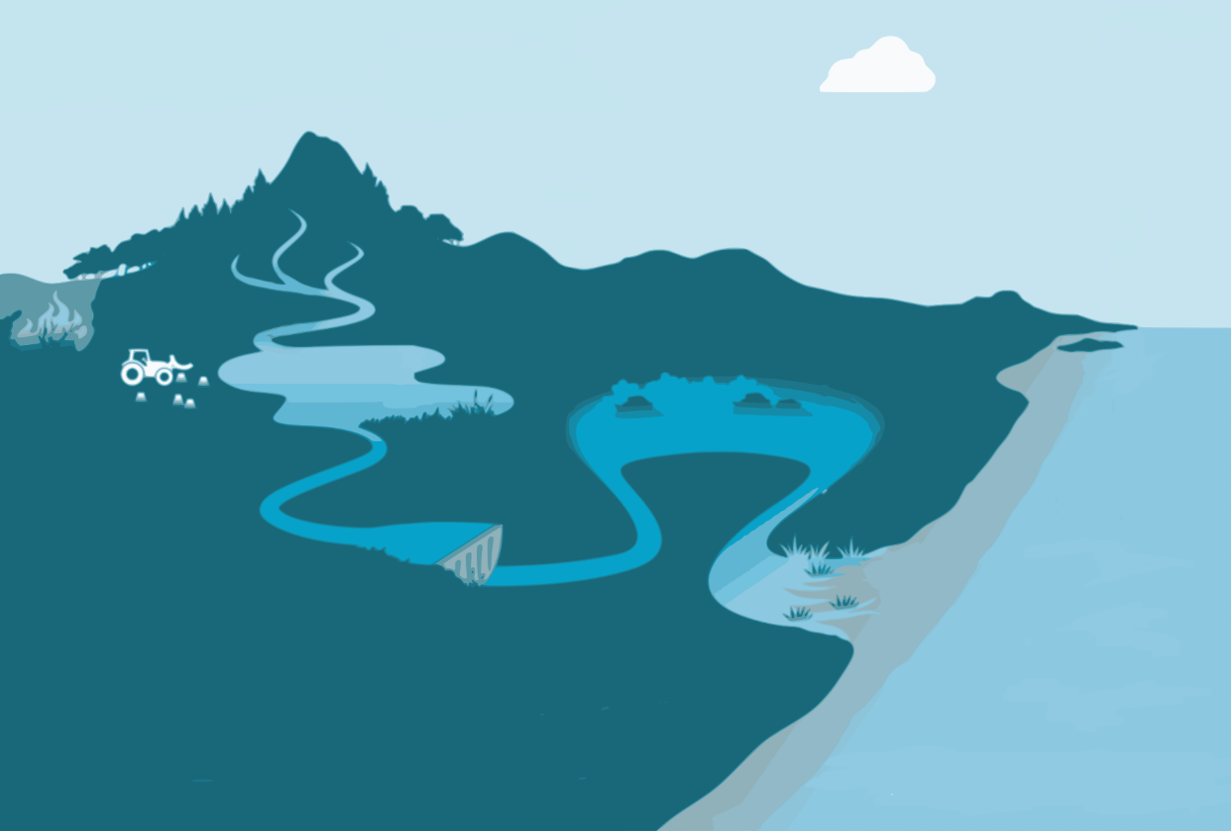





Carbonium
Transfer C
Rivers
Flood plans
wetlands
Scientific objectives
Carbon fluxes from terrestrial to aquatic ecosystems:
Carbon transformation in the terrestrial – aquatic continuum
Carbon storage :
  Aquatic ecosystems (rivers, floodplains, wetlands, lakes)
  Estuaries and coastal ecosystems
CO₂, CH₄
CO₂, CH₄
Coastal wetlands
Stock C
CO₂, CH₄
Stock C
CO₂, CH₄
Lacs
Reservoirs
Stock C
Estuaries
Export C
Stock C
@Global Carbon Project
National French Infrastructures
Critical Zone
Lakes Observatories
Hydrosystems
Coastal Zones
Analytic platforms

Slide 3
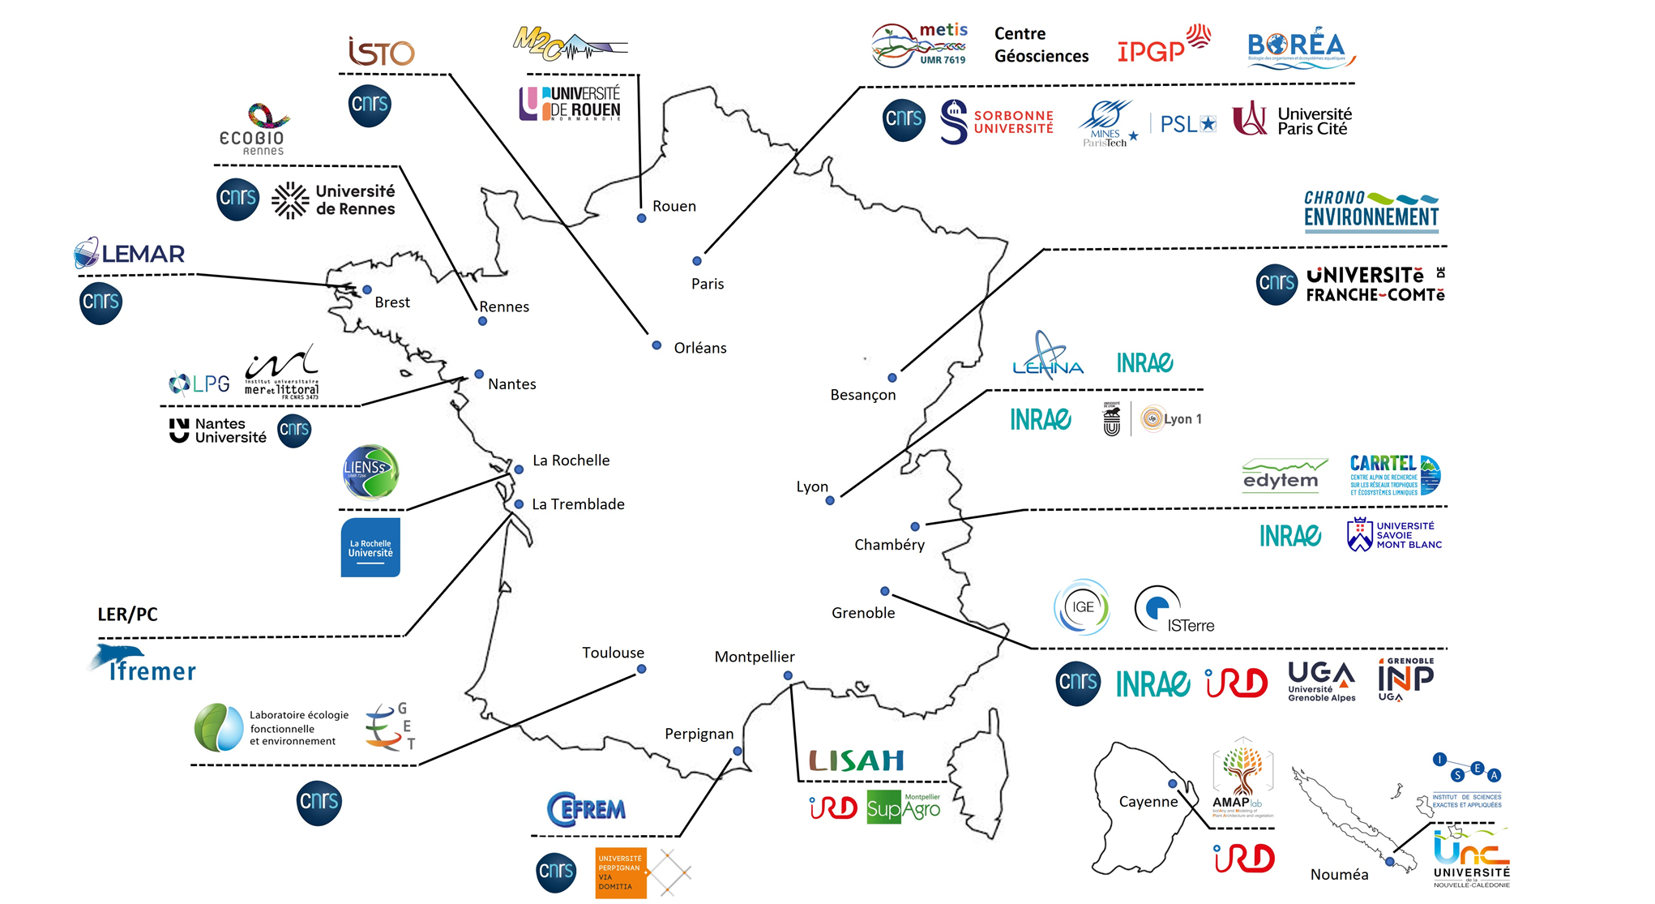
Carbonium
24 laboratories 14 Universities
> 60 researchers 3 Instituts
Building a community along the continuum
Observation densification in obervatories
  Measure additionnal fluvial carbon forms
  Increase measurement frequency
  Link carbon dynamics at different time scales
Link with Terra Forma project
  Develop in situ sensing for dissolved gas
Link between aquatic ecosystems
  Coupled observatories

Slide 4
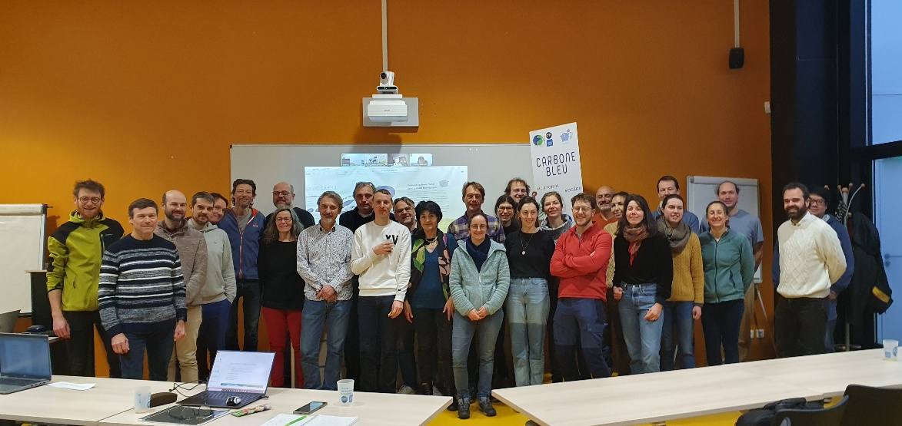
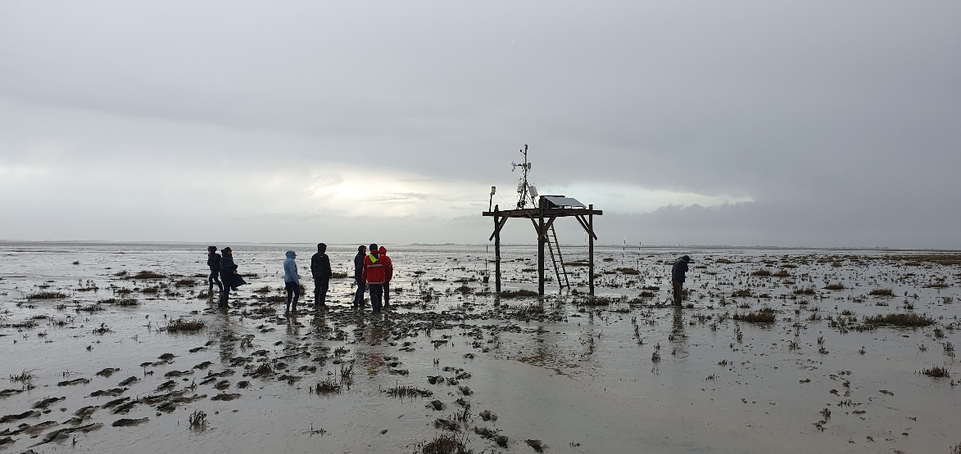
Carbonium
Building a community along the continuum
CarboNium workshop 27-29th January 2025, La Rochelle
Flux tower measurement, Aiguillon Bay

Slide 5
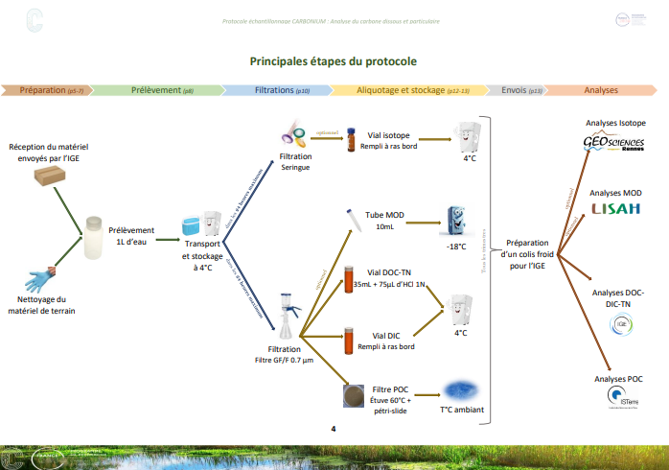
Increase Organic Carbon survey in Critical Zone Observatories
Survey of 12 river sites launched in 2025!
Protocol uniformisation (DOC, POC, DIC)
See Poster Camille Crapart (post doc CarboNium)

Slide 6
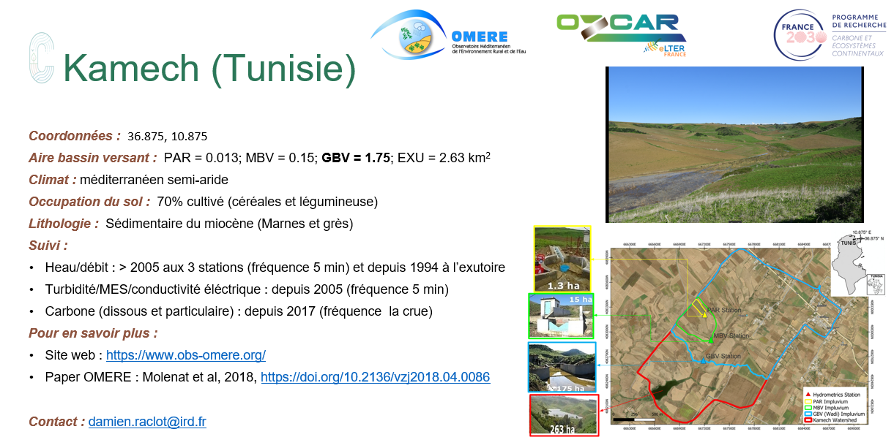
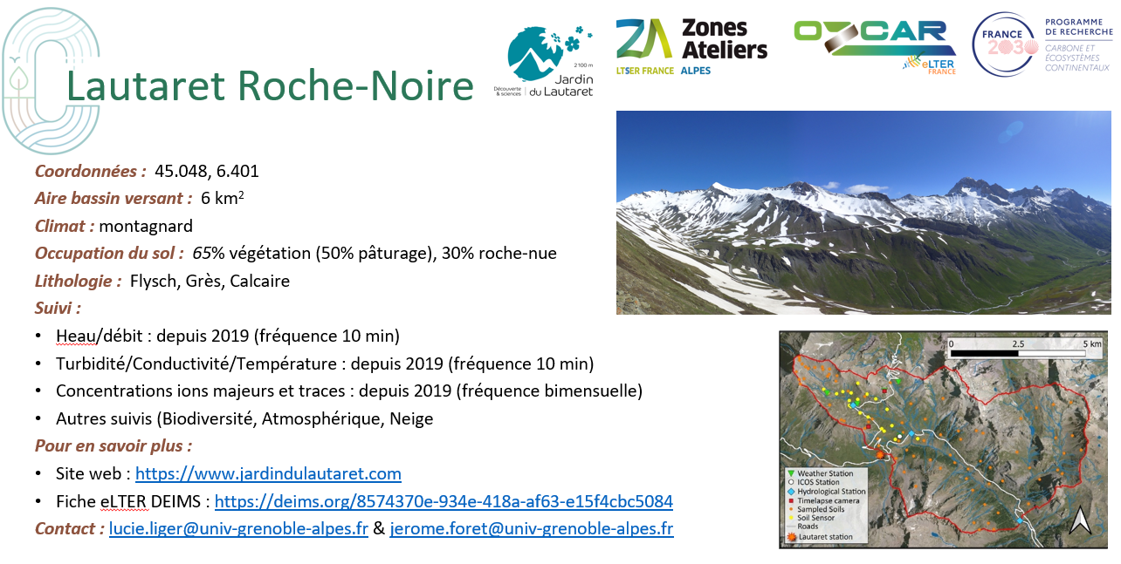
Increase Organic Carbon survey in Critical Zone Observatories
Survey of 12 river sites launched in 2025!
Protocol uniformisation (DOC, POC, DIC)
See Poster Camille Crapart (post doc CarboNium)

Slide 7
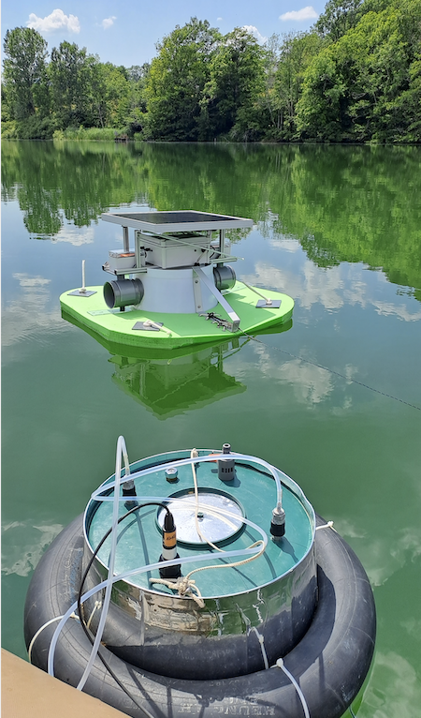
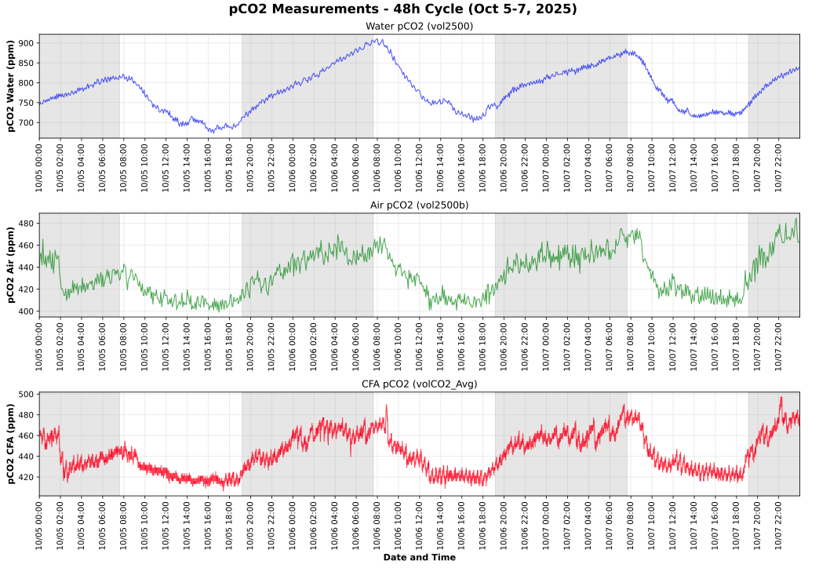

Measure Carbon dynamics from the diurnal scale….
Diurnal C evasion cycles in lakes…..
Automatic floating chamber
Manual floating chamber
Viet Van Tran, Didier Jezequel, WP7

Slide 8
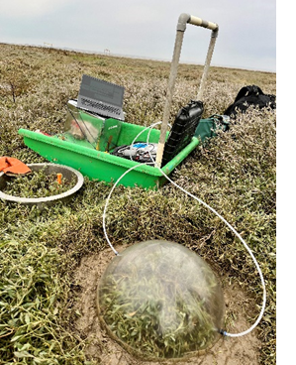
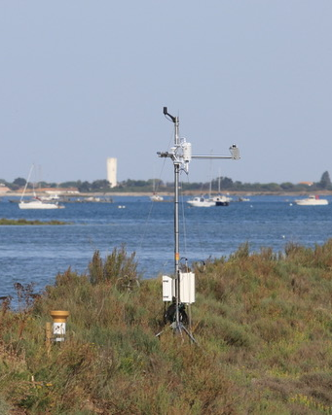
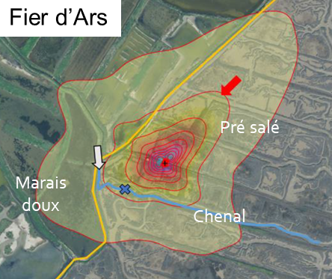
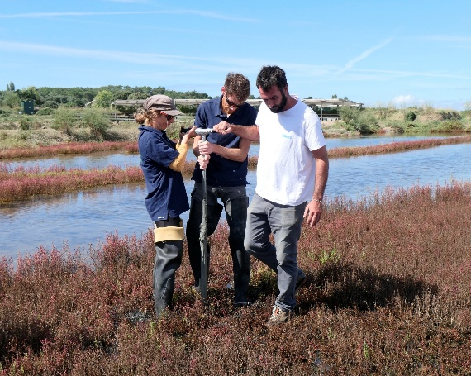
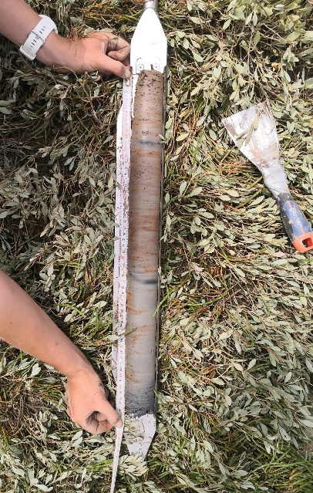


… to the annual to decennal scale
Carbon sequestration (decades/ centuries)
Carbon uptake (season/ years)
Flux tower
Core sampling
Static chambers
See poster Benjamin Amann (post doc CarboNium)

Slide 9
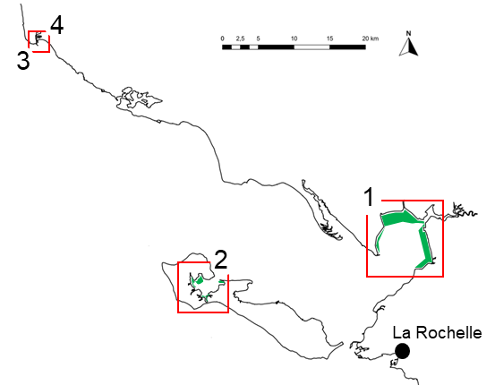
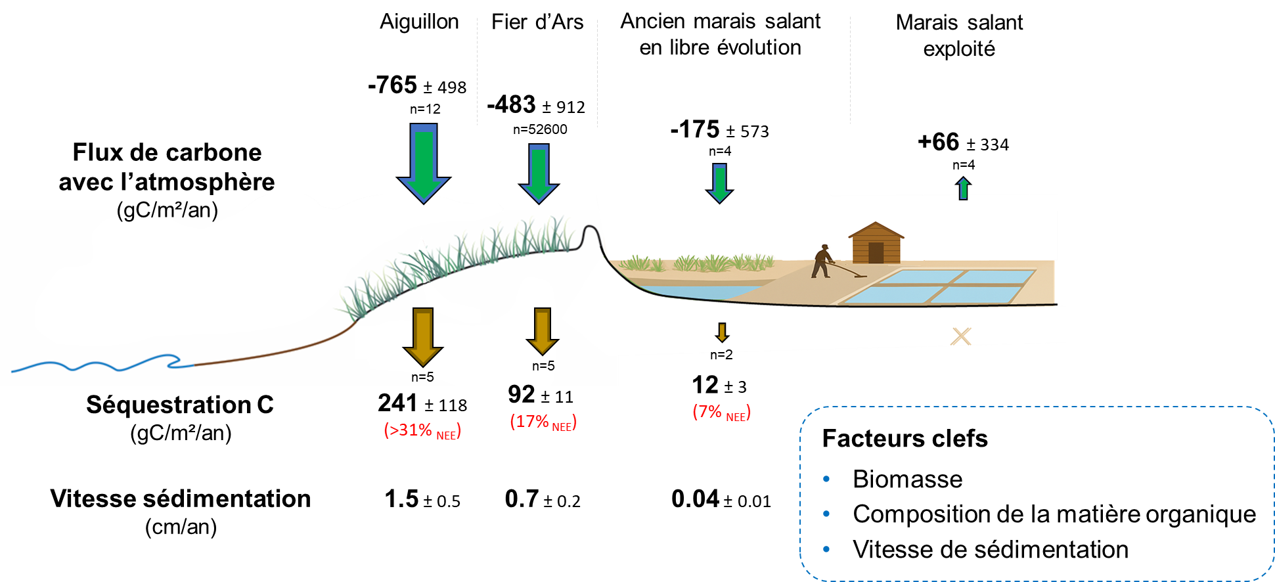
… to the annual to decennal scale
Sarrazin E., Rapport M2 CarboNium 2025
Amann et al., 2024; Mayen et al., 2024; Perry et al., in prep

Slide 10

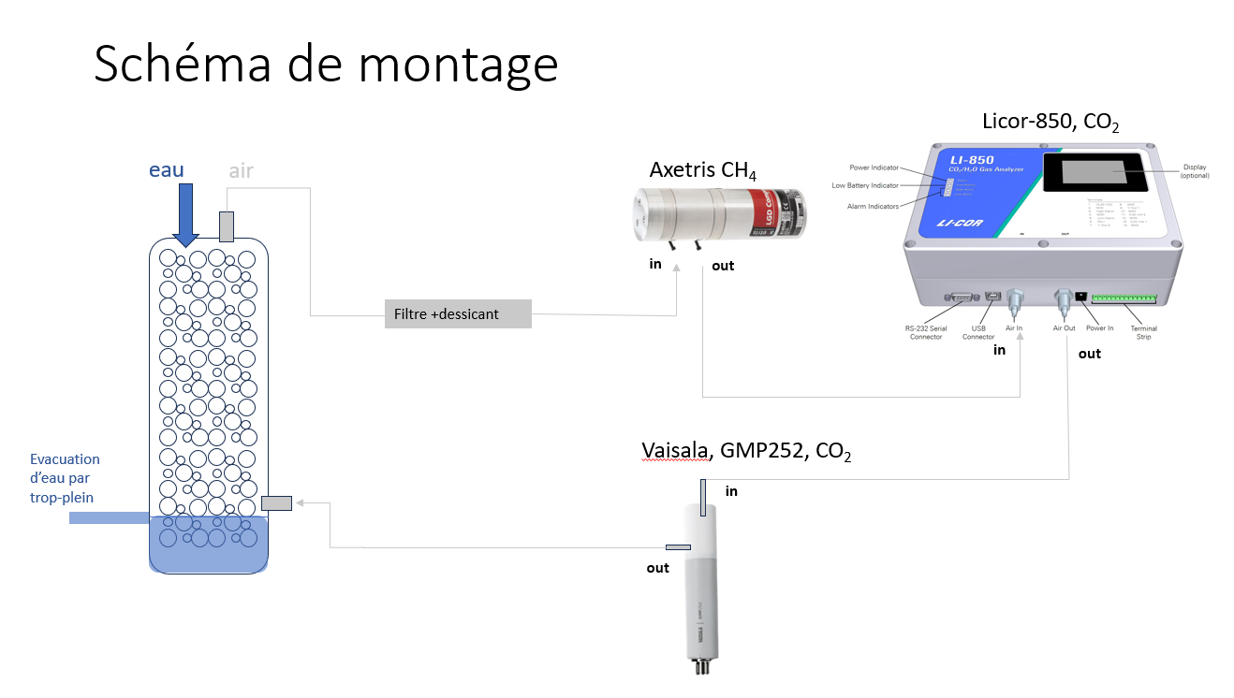
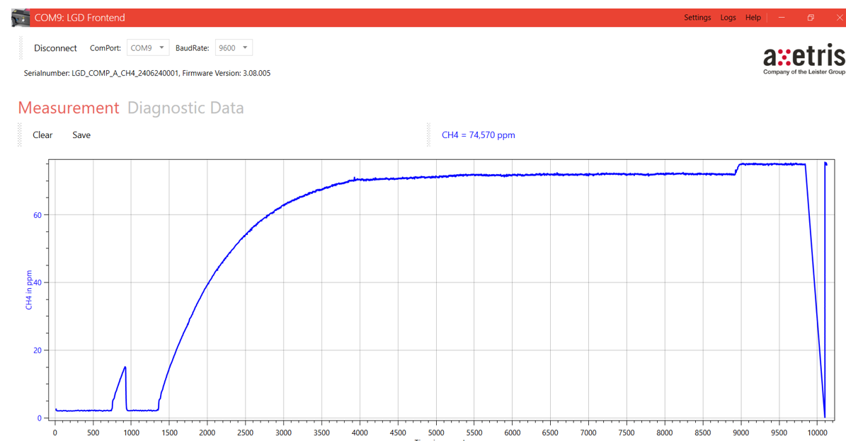
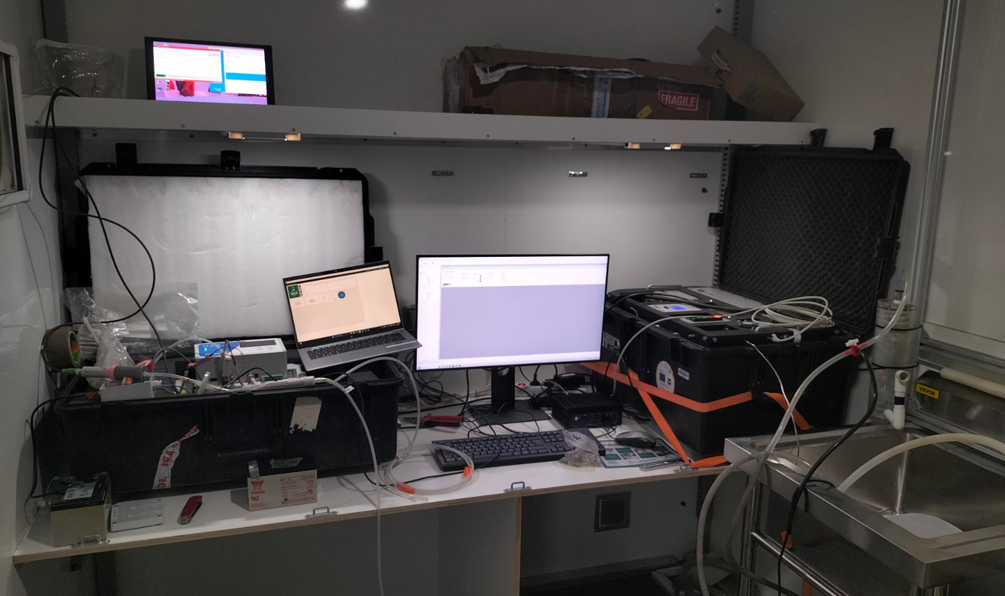
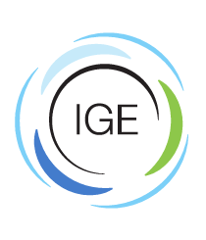

Develop GHG in situ sensing solutions
Development of New in situ sensing systems for CH₂ and CH₄
Test in Guidel, 6 June 2025
Common sites with Terra Forma project
See Poster Matthieu Gilles (PhD CarboNium/Terra Forma)
See Poster Noémie Poteau (PhD Univ. Pasteur)

Slide 11

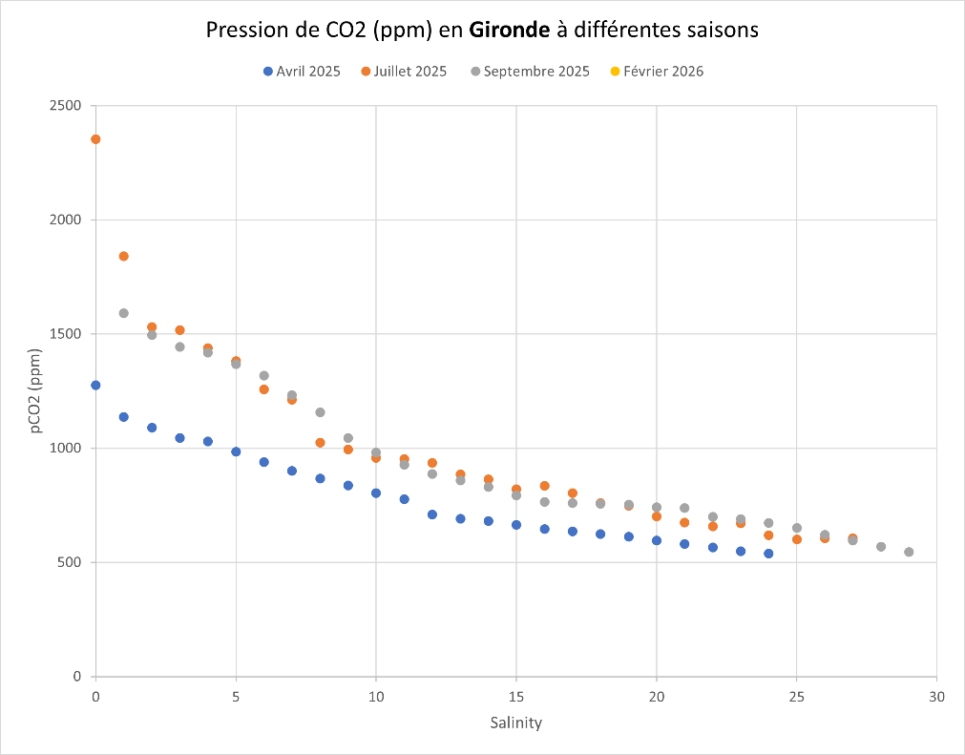
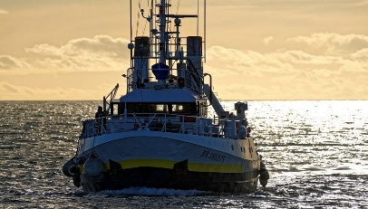
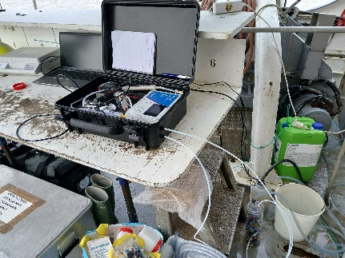
Measure dissolved GHG (CO₂, CH₄, N₂O) in French River estuaries
GIRONDE
New GHG measurements during seasonal survey campaigns
pCO₂ (ppm)
Thalia – mission SOGIR
2025
2026
Gironde (3), Rhône, Seine
Gironde, Loire
See Poster Roxane Ory (IE CarboNium)
Salinity

Slide 12
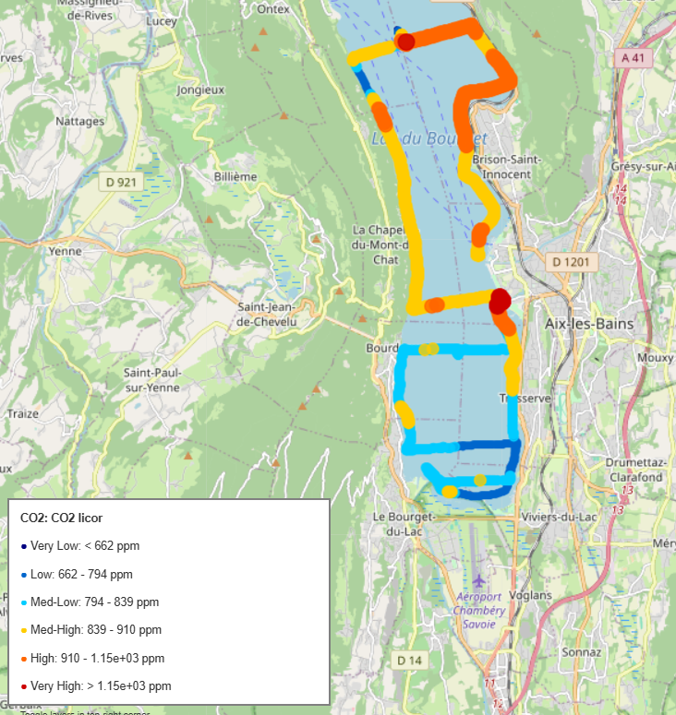
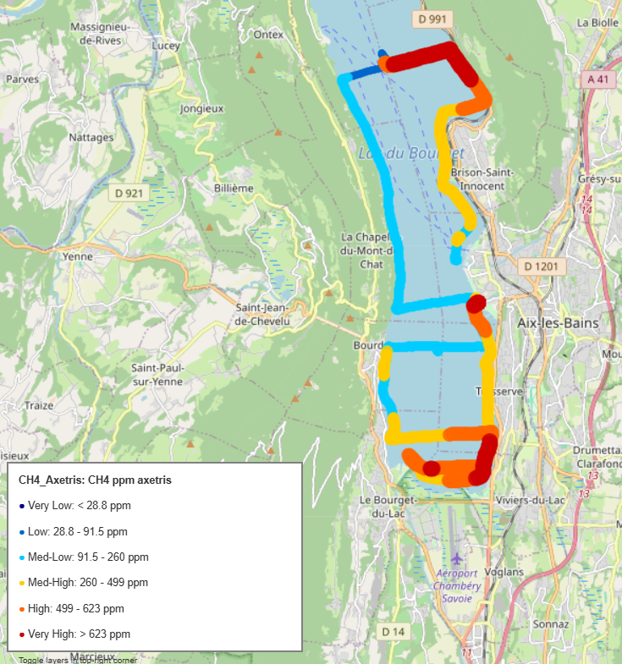
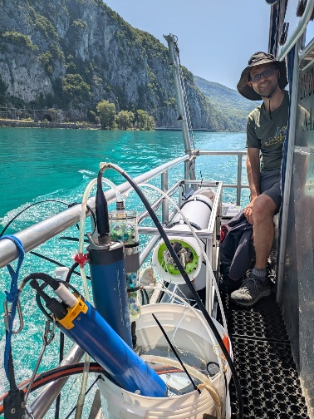
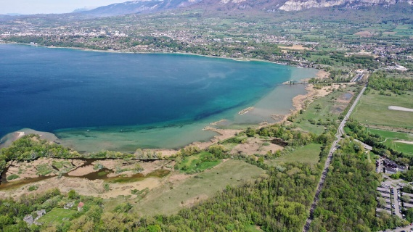

Link between Aquatic Ecosystems
Is CH₄ dynamics influenced by river inputs?
CO₂ / CH₄ survey in Bourget Lake (june 2025)
Mapping 2D
Instruments comparisons
Inputs from Leysse River basin
DOC, POC, DIC monitoring at outlet
Weekly and flood periods (from June 2025)

Slide 13
2025 highlights and 2026 perspectives
Building and strengtening a fluvial carbon community
Implement new carbon survey in observatories
Increase GHG survey on coastal ecosystems
Towards an integrated modelling strategy

Slide 14
Thanks
Next Carbonium Days to come soon in 2026…..

