Slide 1
FairCarboN
Alkalinity production and advective transport (tidal pumping) contribute to carbon sequestration in tidal flats
Paul Kanfer¹, Pierre Anschutz¹, Céline Charbonnier¹, Dominique Poirier¹, Bruno Deflandre¹, Martin Danilo¹, Charlène Steinmetz¹, Jimmy Desnues¹, Gérard Lebreton¹, Sabine Schmidt¹, Aurélia Mouret², Eric Beneteau², Lionel Denis³, Florian Cesbron⁴, Maxime Daviray⁴
CABESTAN
1
4
3
2

Slide 2
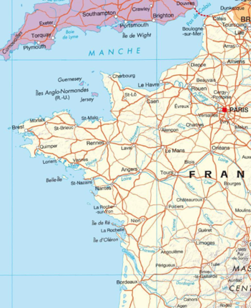
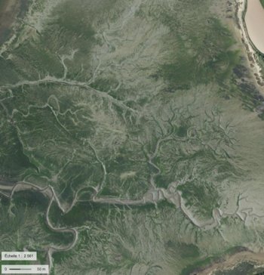
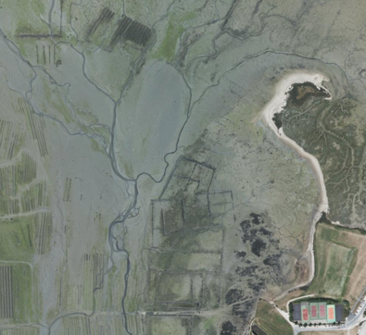
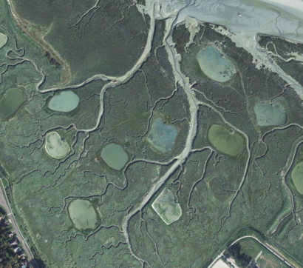
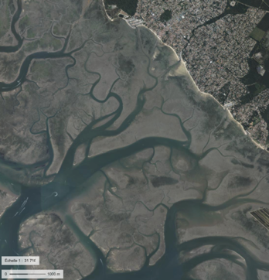
CABESTAN: C sequestration in intertidal zones
• Intertidal zones are the site of biogeochemical reactions in which organic matter is recycled and biogenic compounds are exchanged between sediment and water.
• Intertidal zones are drained by tidal channels
• Tidal channels drain pore water at low tide
• Benthic fluxes : diffusive (high tide) versus advective (tidal pumping, low tide) contribution
⌦
⌦
⌦
⌦
⌦
⌦
Ledano Bay, Trieux estuary
St Vaast la Hougue Bay
Canche estuary
Arcachon Lagoon

Slide 3

CABESTAN: C sequestration in intertidal zones
O₂
NO₃⁻
SO₄²⁻
High tide
Diffusive fluxes
CO₂
DOC
NH₄⁺
PO₄³⁻
Fe²⁺
Alka
•Early diagenesis generates biogeochemical gradients
Organic matter
mineralization
•Gradients generate fluxes
•Fluxes are diffusive and advective
(HCO₃⁻ + CO₃²⁻)
O₂
CO₂
Low tide
Tidal pumping
CO₂
DOC
NH₄⁺
PO₄³⁻
Fe²⁺
Alka
Organic matter
mineralization

Slide 4
CABESTAN: C sequestration in intertidal zones
Alkalinity export = long term sequestration of C
sum of charges carried by cations associated with strong bases (Na⁺ + 2 Mg²⁺ + 2Ca²⁺ + K⁺ + 2Sr²⁺ ) = 605.6 mmol/kg
Alkalinity = 2.3 mmol/kg
sum of charges carried by anions associated with strong acids
(Cl⁻ + 2SO₄²⁻ + Br⁻ + F⁻ ) = 603.3 mmol/kg
Alka = sum of active charges
≃ HCO₃⁻ + 2CO₃²⁻ + (OH⁻ - H⁺)

Slide 5
CABESTAN: C sequestration in intertidal zones
Alkalinity export = long term sequestration of C
(Na⁺ + 2 Mg²⁺ + 2Ca²⁺ + K⁺ + 2Sr²⁺ )
Alkalinity = 2.3 mmol/kg
(Cl⁻ + 2SO₄²⁻ + Br⁻ + NO₃⁻ )
NO₃⁻ + 1.25 CH₂O => 0.25 CO₂ + HCO₃⁻ + 0.5 N₂ + 0.75 H₂O
SO₄²⁻ + 2 CH₂O => 2 HCO₃⁻ + H₂S
Fe(III) + S(-II) => FeS₂
Alka = sum of active charges
≃ HCO₃⁻ + 2CO₃²⁻ + (OH⁻ - H⁺)

Slide 6
CABESTAN: C sequestration in intertidal zones
Alkalinity export = long term sequestration of C
(Na⁺ + 2 Mg²⁺ + 2Ca²⁺ + K⁺ + 2Sr²⁺ )
Alkalinity = 2.3 mmol/kg
(Cl⁻ + 2SO₄²⁻ + Br⁻ + NO₃⁻ )
CaCO₃ + CO₂ + H₂O => 2 HCO₃⁻ + Ca²⁺
Alka = sum of active charges
≃ HCO₃⁻ + 2CO₃²⁻ + (OH⁻ - H⁺)

Slide 7
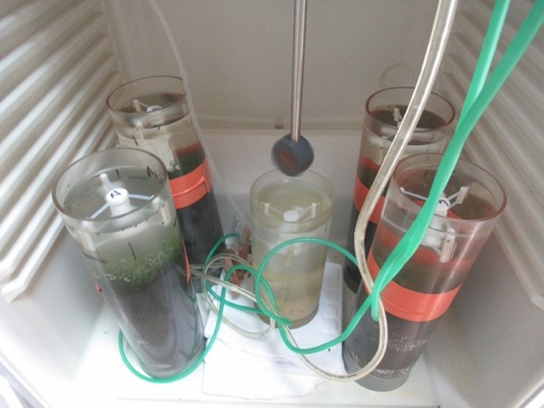
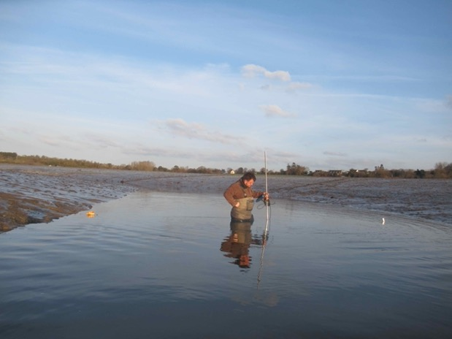



CABESTAN: C sequestration in intertidal zones
Diffusive fluxes Total benthic fluxes Tidal pumping
Sediment incubation
Discharge measurements
Pore water profiles
$Flux=φ × Ds × ΔC/Δz$
$$Flux={(C}_{T1}−C_{T0})/h/ (T_{1}−T_{0})$$
$$Flux= ∆C × Q /S_{drained area}$$

Slide 8
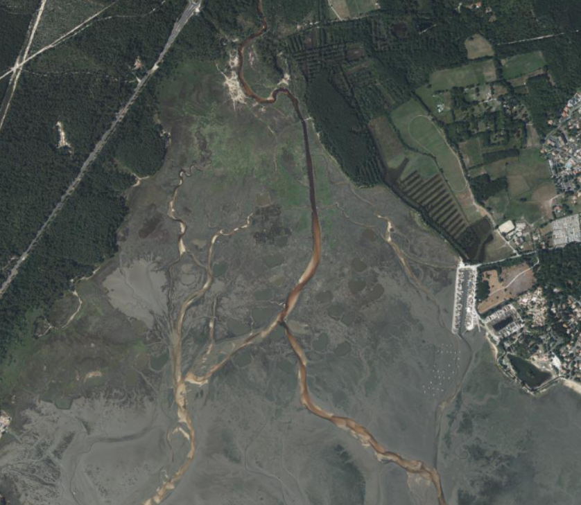
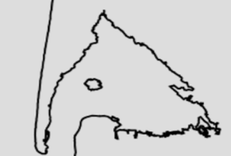

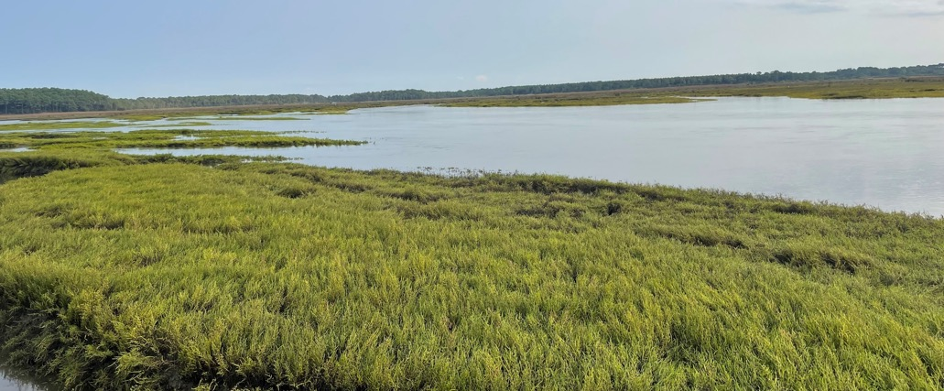
CABESTAN: C sequestration in intertidal zones
2 km² saltmarsh
0.3 km² study area
Example of the salt marshes of the Arcachon lagoon
250 m

Slide 9





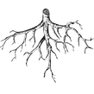
CABESTAN: C sequestration in intertidal zones
Mesured species : DIN (NH₄⁺, NO₃⁻ , NO₂⁻ ), DIP (PO₄³⁻), Fe(II), Mn(II), SO₄²⁻, Sid, TA (=> DIC, pCO₂), DOC and CH₄
General parameters: T°C, pH, S and %O₂
Flow measurement: Velocity fields exploration
Vegetated
area
Unvegetated
mud
Water Sampling and Discharge Mesurement
(discret samples every 30 minutes at ebb tide)
Sediment Cores
(benthic processes and open incubations)

Slide 10
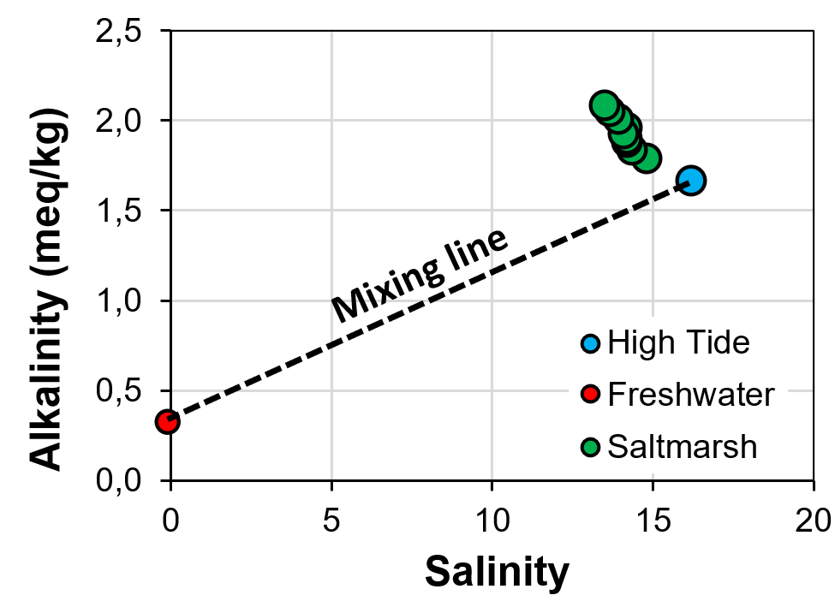
CABESTAN: C sequestration in intertidal zones
15:00
Excess alkalinity
9:00
Tidal channel

Slide 11
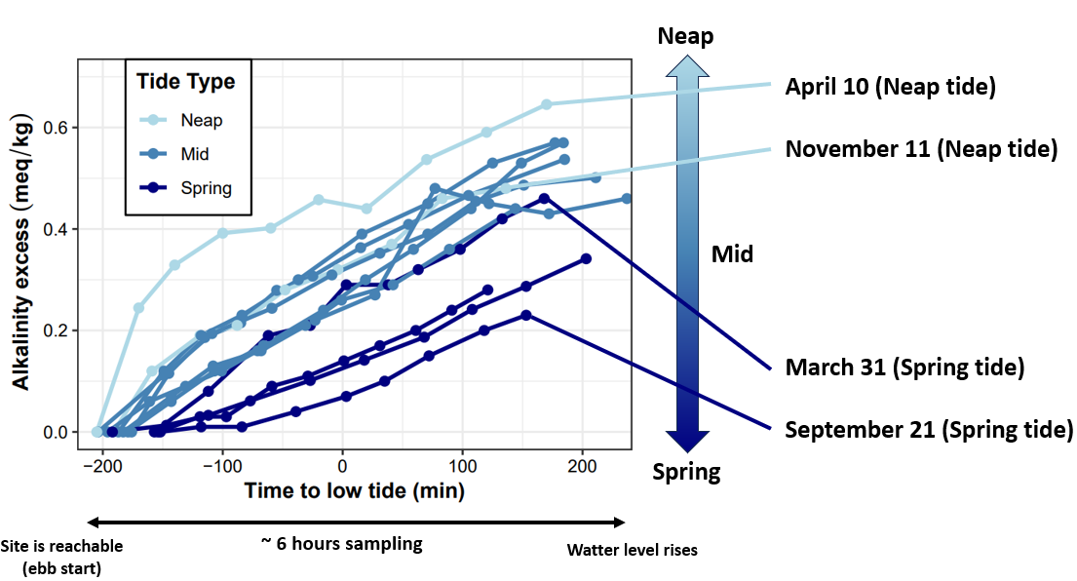
CABESTAN: C sequestration in intertidal zones
Water level rises

Slide 12
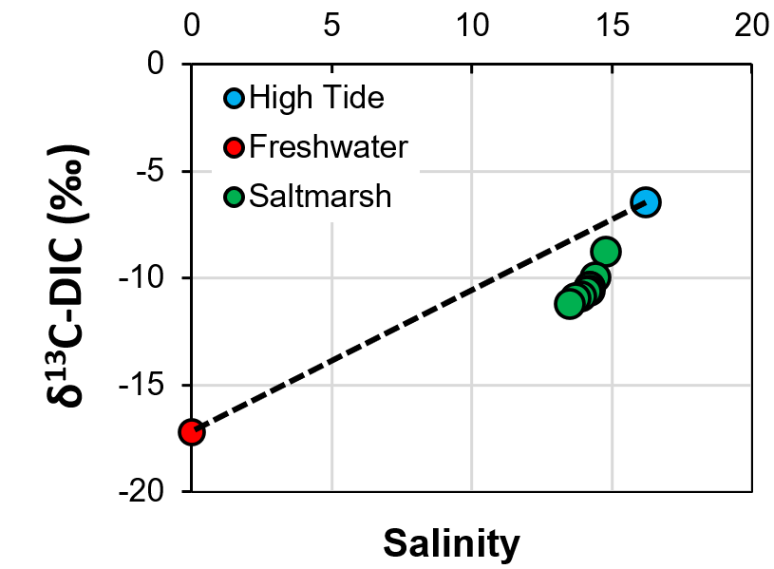
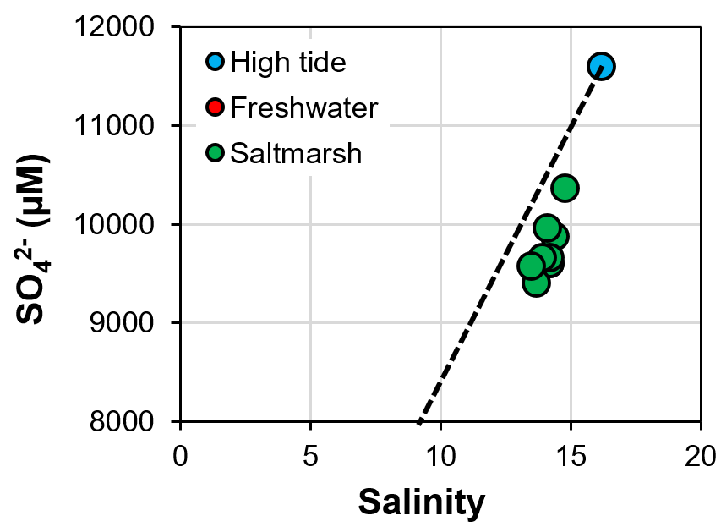
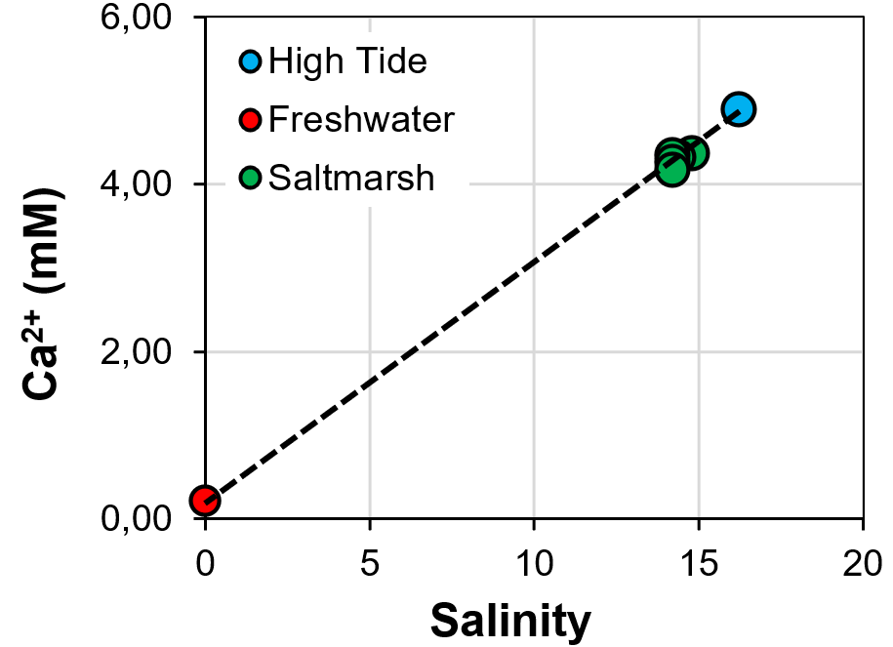
CABESTAN: C sequestration in intertidal zones
6
4
2
0
Tidal channel
Tidal channel
Tidal channel

Slide 13
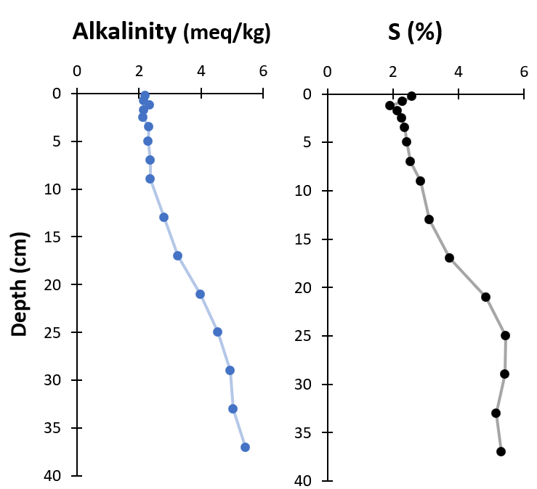
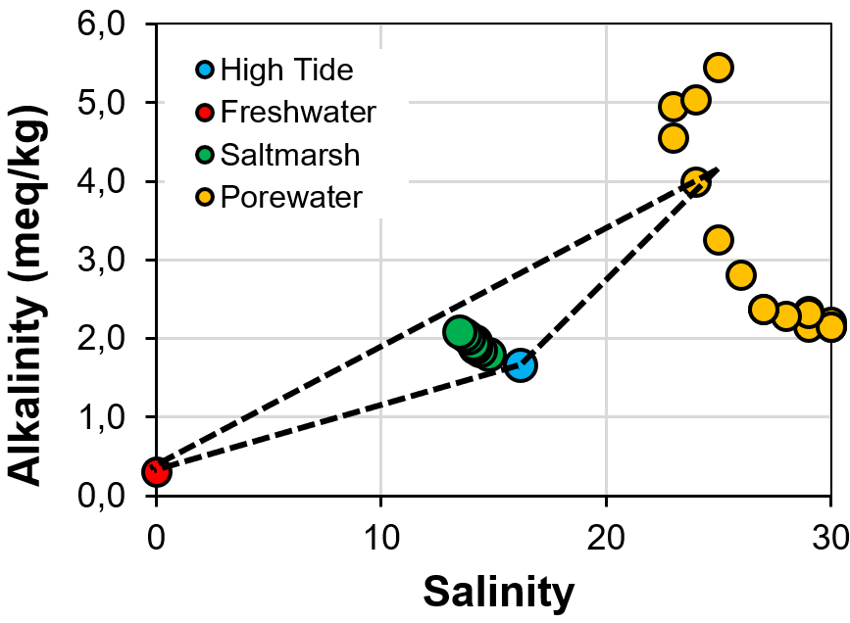
CABESTAN: C sequestration in intertidal zones
6
5
4
3
2
1
0
Tidal channel

Slide 14
CABESTAN: C sequestration in intertidal zones
High tide
Dissolved inorganic C
31 t/yr
For Arès Saltmarshes
(2 km²)
Diffusive fluxes
CO₂
DOC
NH₄⁺
PO₄³⁻
Fe²⁺
Alka
(HCO₃⁻ + CO₃²⁻)
O₂
CO₂
Low tide
Tidal pumping
CO₂
DOC
NH₄⁺
PO₄³⁻
Fe²⁺
Alka
Organic matter
mineralization
Dissolved inorganic C
100 t/yr

Slide 15

CABESTAN: C sequestration in intertidal zones
Alkalinity enrichement in tidal creeks due to anaerobic OM transformation
Alkalinity export due to tidal pumping (ebb) and diffusive fluxes (high tide) of porewaters
Dissolved inorganic carbon fluxes are in the same order than classical blue carbon (~10 MtC/y)
⌦
⌦
⌦
⌦
⌦
⌦

