Slide 1





2D-DET gels for porewater imaging of mineralization-related solutes at high spatial resolution in mangroves
Edouard Metzger, Aurélia Mouret, João Barreira, Matheus Cavalcante, Wilson Machado, Pierre Gaudin, Cleuza Beatriz Trevisan, Murilo Kurita, Christiene Matos, Alexandre Mantrant and Gwenaël Abril
TROPECOS Project

Slide 2


Redox zones and microenvironments in sediments
Microheterogeneities:
bioturbation/bioirrigation
OM patches
production/consumption of solutes by roots, burrows
Development of in situ, high-resolution methods:
1 dimension:
- microelectrodes, 50-100 µm
1D DET, mm
(diffusive equilibration in thin films )
1D DGT, mm
(diffusive gradients in thin films)
2 dimensions:
- 2D DGT, 100 µm
- planar optodes, µm
- 2D DET, µm to mm
OM
Water
Sediment
O₂
Oxic zone
NO₃⁻
MnO₂
O₂
O₂
Suboxic zone
O₂
O₂
NO₃⁻
few cms
Fe(OH)₃
Mn²⁺
Fe²⁺
PO₄³⁻
SO₄²⁻
Anoxic zone
HS⁻
z

Slide 3
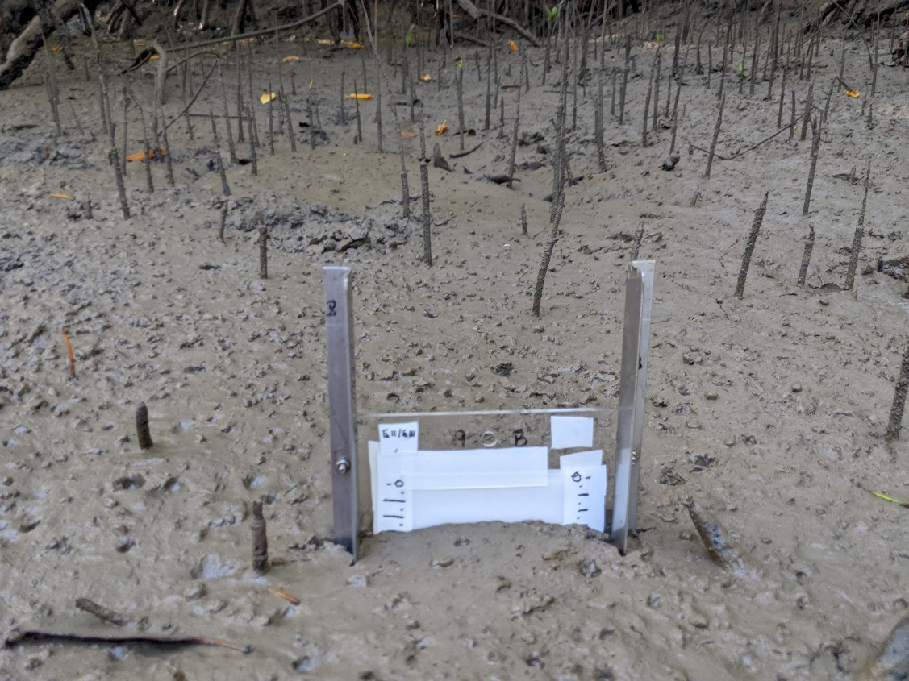
2D-DET
Diffusive Equilibrium in Thin film (DET)
Davison et al., Nature, 1991
80 mm
0.2 μm pvdf membrane
Polyacrylamide gel
165 mm
a
3 mm
In situ sampling with a hydrogel probe → diffusional equilibrium with porewater solutes
Representativeness of porewater composition on a short time (4-5h)

Slide 4
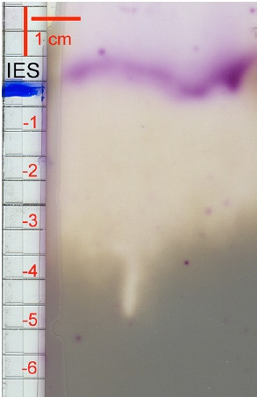
2D-DET + colorimetry
Jézéquel et al., Estuarine, Coastal & Shelf Science, 2007
Colorimetric methods: reliable, specific, highly sensitive
Superposition of a probe gel and a reagent gel → rapid appearance of coloration
« reagent gel » equilibrated with a solution of a colorimetric reagent
Dissolved Fe
« probe gel » equilibrated with porewater solutes within the sediment
S(-II) by DGT-like tape
→ Acquisition of a picture with a flatbed scanner
Reaction time < 5 min

Slide 5
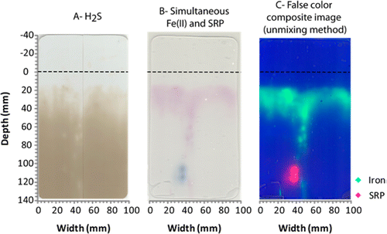
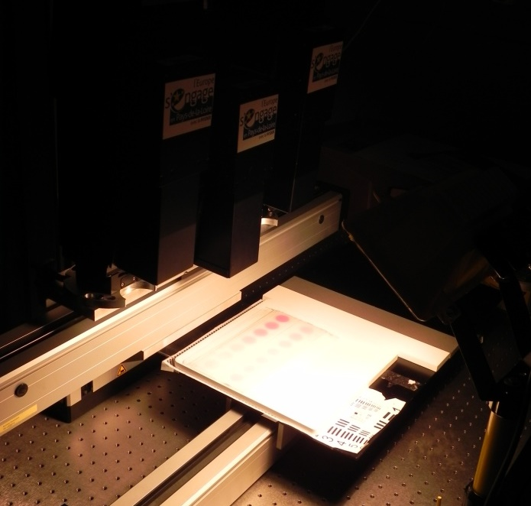
2D-DET + colorimetry + hyperspectral imagery
Cesbron et al., Environmental Science & Technology, 2014
Simultaneous Fe and DRP
Reagent gel for Fe
Hyperspectral camera
Probe gel
Reagent gel for DRP
gels
Spectral resolution: 4.5 nm

Slide 6
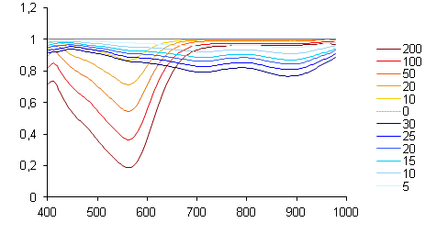
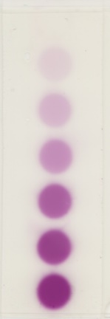
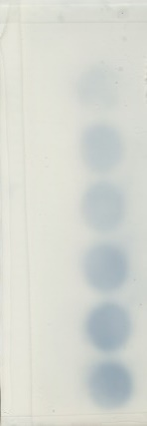
2D-DET + colorimetry + hyperspectral imagery
False color composite image (unmixing method)
Simultaneous Fe and DRP
Fe
DRP
0 µM
0 µM
Fe
Reflectance
DRP
200 µM
30 µM
Wavelength (nm)
Cesbron et al., ES&T, 2014

Slide 7
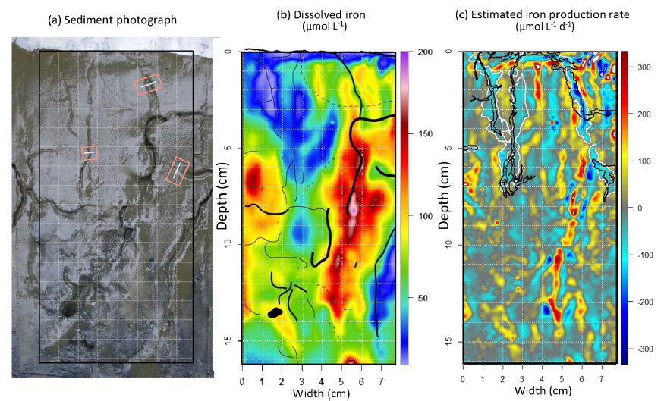
2D-DET + … + 2D modeling of production rates and fluxes
Thibault de Chanvalon et al., Marine Chemistry, 2017
quantification of Fe production/consumption rates
Decomposition of OM by Fe-oxide reduction:
(CH₂0)(NH₃)_{X}(PO₄)_{Y} + 2Fe₂O₃ + 8H⁺ → CO₂ + xNH₃ + yH₃PO₄ + 5H₂O + 4Fe²⁺
Fe-oxide formation with potential OM adsorption, co-precipitation, or aggregation :
Fe²⁺ + 0.5O₂ + H₂O → 0.5Fe₂O₃ + 2H⁺
Fe²⁺ + 0.2HNO₃ → Fe(OOH) + N₂ + 2H⁺
Fe²⁺ + 0.5MnO₂ + 0.5H₂O → 0.5Fe₂O₃ + 0.5Mn²⁺ + H⁺
→ evaluation of OM remineralisation/preservation and CO₂ production rate

Slide 8




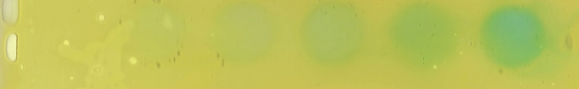




Developments of other colorimetric 2D-DET methods
Iron
Nitrite/nitrate
Siderophores
Jézéquel et al., 2007; Cesbron et al., 2014
Metzger et al., 2016
Le Houedec et al., 2024
Phosphate
Ammonium
Sulfide
Pagès et al., 2011; Cesbron et al., 2014
Metzger et al., 2019
Kankanamge et al., 2020
Manganese
Alcalinity
pH
Mouret et al., 2024
Bennett et al., 2015
Barreira et al., in prep.

Slide 9
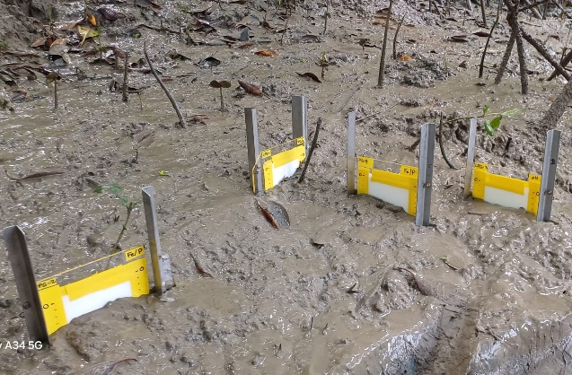
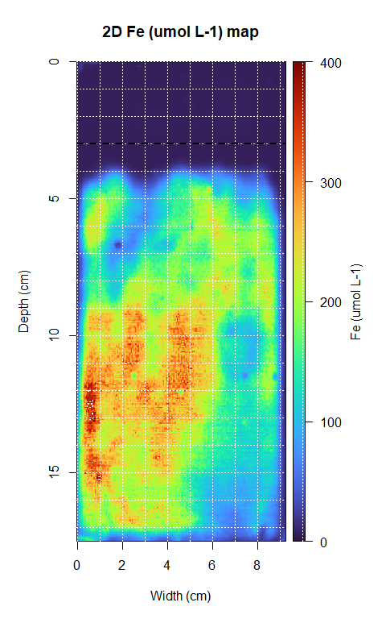
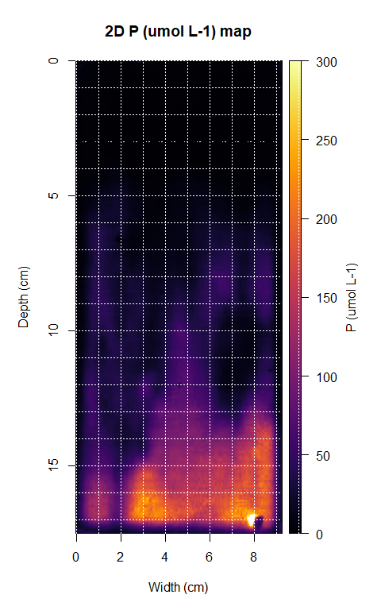
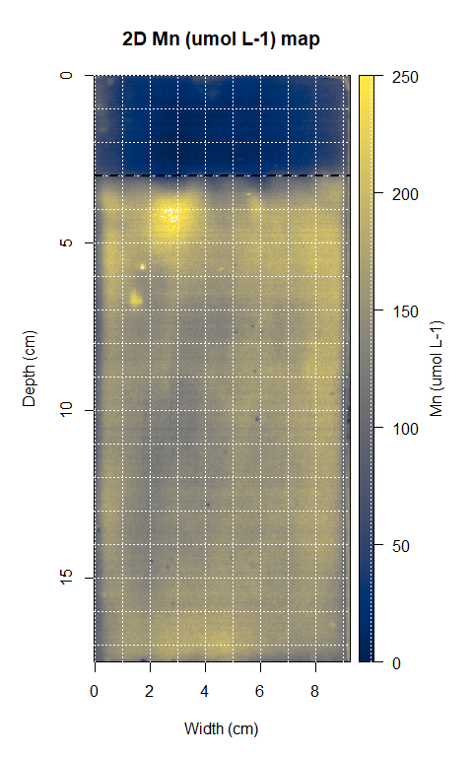
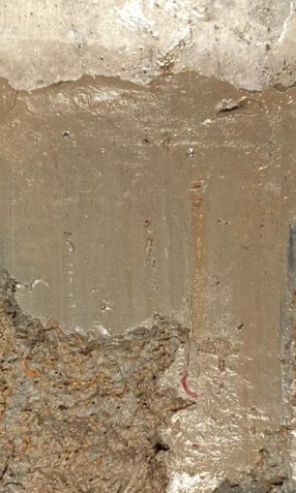
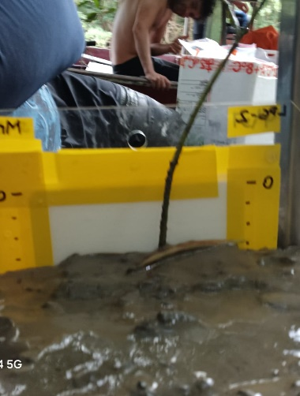
Example from mangroves sampled by the TROPECOS project
Marapanim, Northern Brazil, winter 2025
Sediment slice
Young Rhizophora

Slide 10
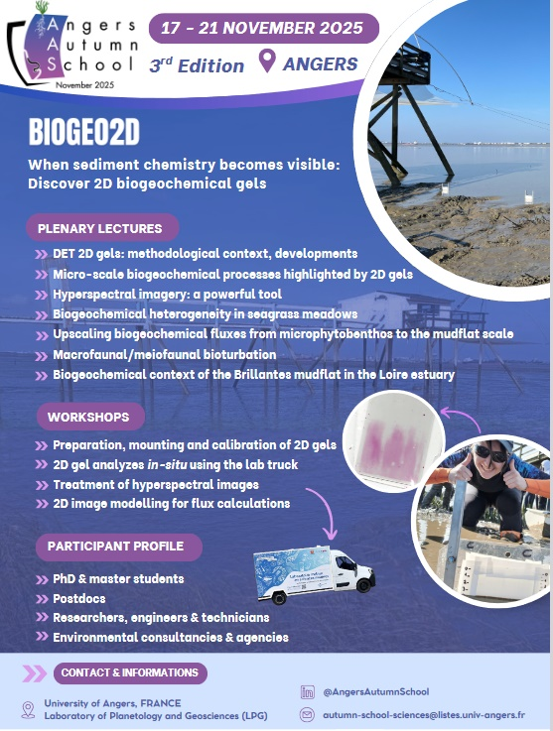
Autumn School BIOGEO 2D
17-21 Nov. 2025
and next year!
Supported by FaircarboN

Slide 11
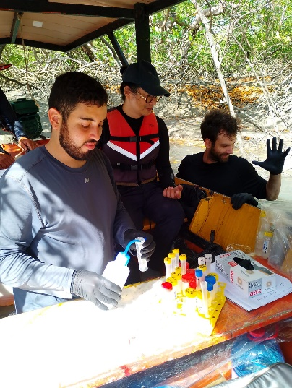
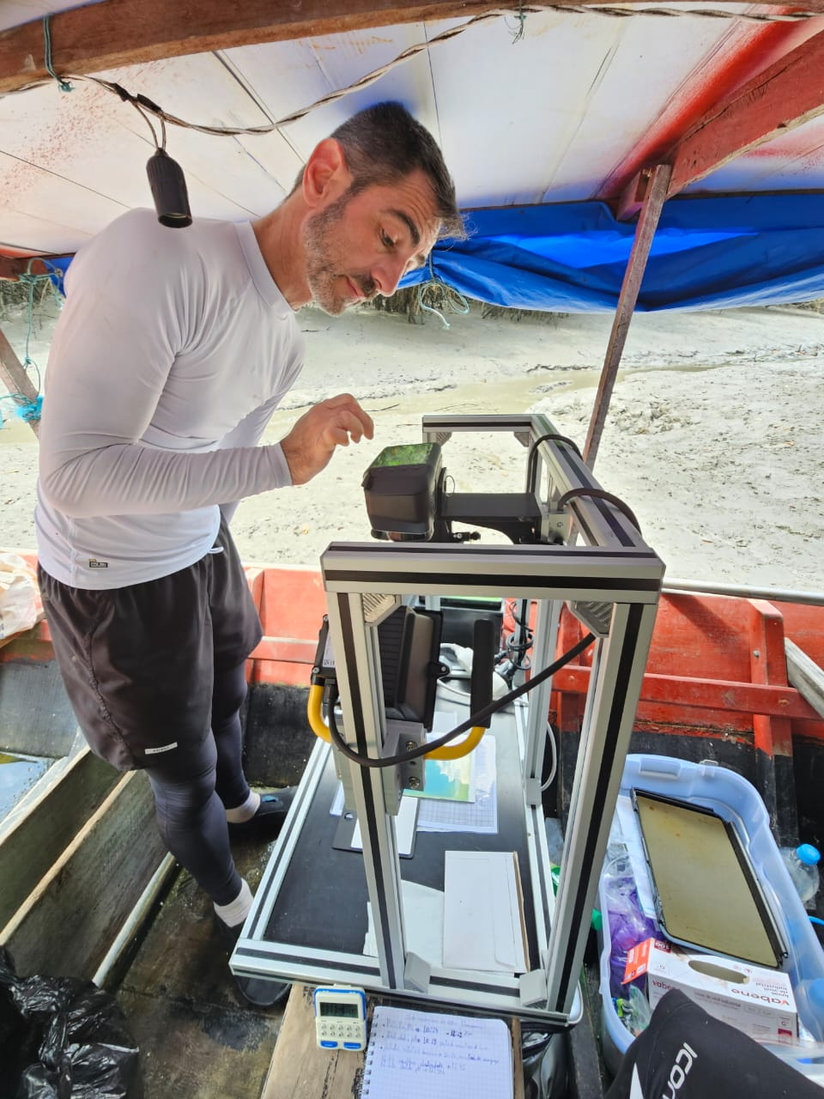

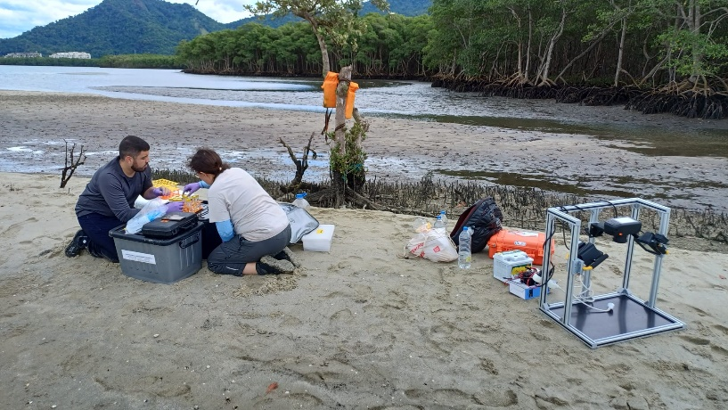


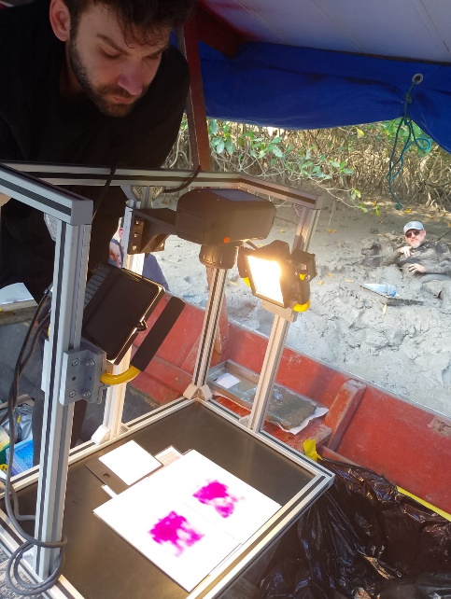



Thank you for your attention!

