Slide 1
CO₂_CMφ
CO₂ concentration mechanisms in photosynthetic micro-organisms
How aquatic photoautotrophic micro-organisms adapt to varying dissolved inorganic carbon (DIC) concentrations and CO₂/O₂ ratio, whilst maintaining such an efficiency in CO₂ fixation?

Slide 2
In aquatic environments photosynthesis is limited by CO₂ diffusion
Diffusion coefficient
of CO₂
CO₂ fixation rate by Rubisco
Kc
[CO₂]
Air
0.19 cm² s⁻¹
Savir et al. (2010) PNAS
Water
0.00021 cm² s⁻¹
At 400 ppm CO₂ in the atmosphere, dissolved CO₂ (15µM at 20°C) is low for photosynthesis…
CO₂ diffusion is slow in water…

Slide 3
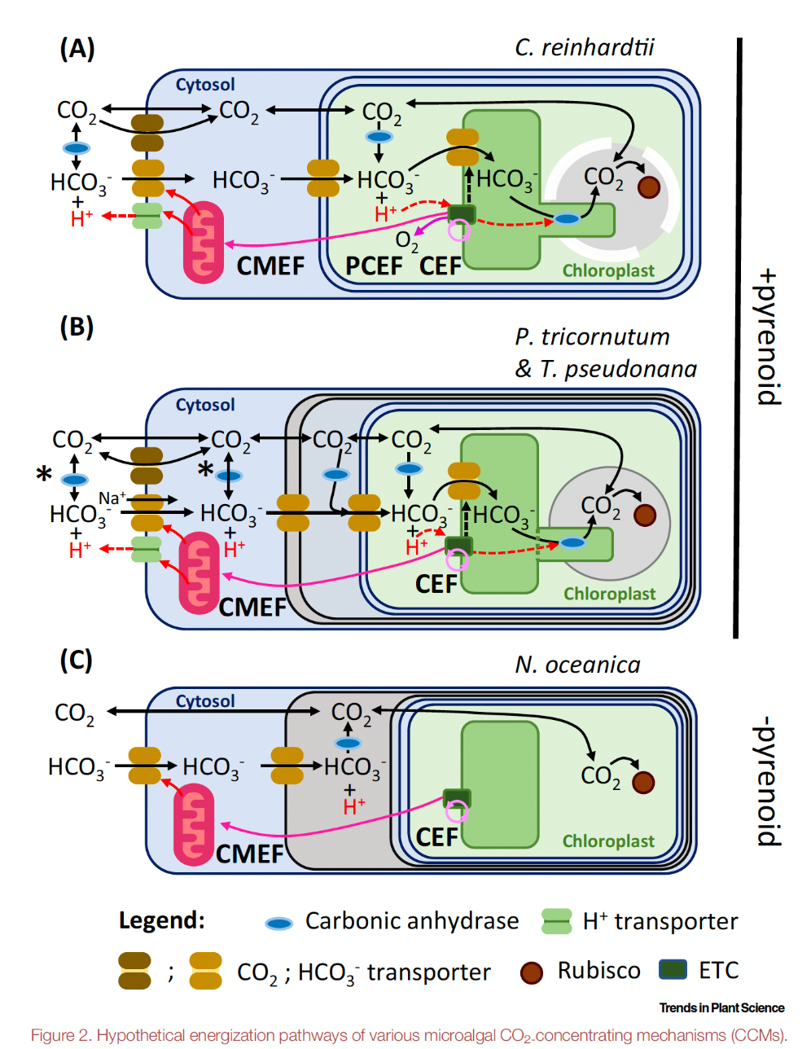
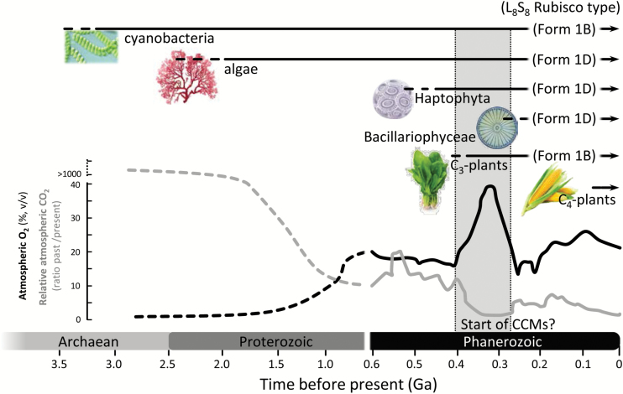
Diverse forms of CCMs appeared after emergence of the different plant lineages
Heureux et al. (2017) J. Exp. Bot.
Burlacot & Peltier (2023) Trends in Plant Science

Slide 4
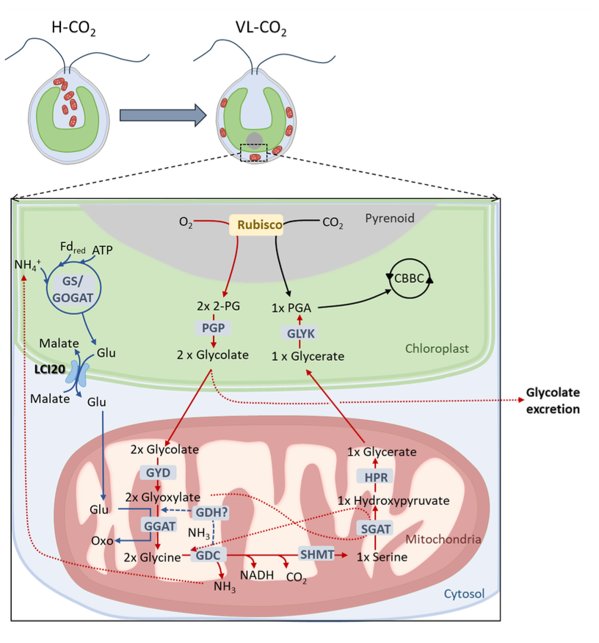
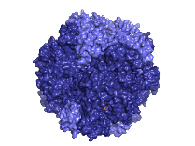
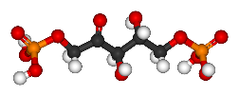



CO₂ fixation by photosynthetic microorganisms
Photosynthesis
RuBisCO
CO₂ + RuBP
Scaffold
protein
2x 3PGA
Photorespiration
O₂ + RuBP
carbonic
anhydrase
3PGA
+
H⁺ + ${\text{HCO}}_{\text{3}}^{\text{−}}$⇌ H₂O+ CO₂
2PGA
Dao et al. (2025) Nature Com.

Slide 5


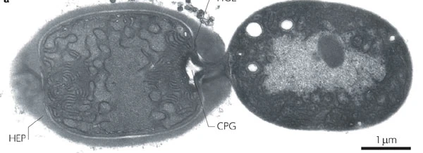


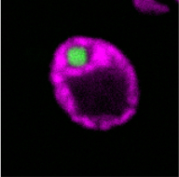
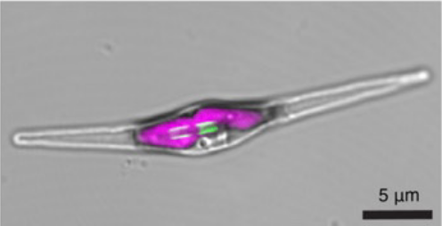

Objectives of the CO₂_CMφ project
carbonic
anhydrase
H⁺ + ${\text{HCO}}_{\text{3}}^{\text{−}}$⇌ H₂O+ CO₂
RuBP
Anabaena PCC 7120
3PGA
2PGA
Chlamydomonas reinhardtii
What are the molecular key features that drive RuBisCO condensation?
What are the physico-chemical properties of the RuBisCO condensates?
What are the consequences of the liquid-liquid interface on the metabolic flux?
What are the consequences of RuBisCO location and organisation on carboxylation and oxygenation activities; metabolic and carbon fluxes?
Phaeodactylum tricornutum

Slide 6
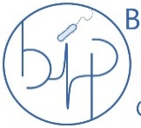



Consortium and CO₂ emission
Biochemists, microbiologists, spectroscopists in “Région Sud”
Local proximity of the consortium
Shared use of equipments
Bioénergétique
et Ingénierie
des Protéines
Institut de Biosciences et Biotechnologies d'Aix-Marseille
Laboratoire
Chimie
Bactérienne
Institut
de Microbiologie
de Méditerranée
Hélène Launay
Frédéric Carrière
Véronique Receveur-Bréchot
Gilles Peltier
Yonghua Li-Beisson
Matthieu Bergé
Amel Latifi
Olivier Bornet
→ limited travelling and CO₂ emission

Slide 7
Objectives of the CO₂_CMφ project
carbonic
anhydrase
H⁺ + ${\text{HCO}}_{\text{3}}^{\text{−}}$⇌ H₂O+ CO₂
RuBP
Anabaena PCC 7120
3PGA
2PGA
Chlamydomonas reinhardtii
What are the molecular key features that drive RuBisCO condensation?
What are the physico-chemical properties of the RuBisCO condensates?
What are the consequences of the liquid-liquid interface on the metabolic flux?
What are the consequences of RuBisCO location and organisation on carboxylation and oxygenation activities; metabolic and carbon fluxes?
Phaeodactylum tricornutum

Slide 8
Does photorespiration occur in the presence of a functional CCM?
How the supramolecular organization of Rubisco affects photorespiration?
CO₂
Glycolate excretion
ACA4
H⁺
CO₂ + NH₃
CAH1
serine
glycine
H⁺
CO₂
NADH
glyoxylate
ATP
GYD
CO₂
ATP
LCI1
CO₂
HCO₃⁻
ATP
ATP
HLA3
HCO₃⁻
ATP
Carbon
Reduction
Cycle
glycolate
NADP⁺
Photorespiration
Low CO₂
LCI1A
NADPH
Very Low CO₂
H⁺
HCO₃⁻
CEF &
PCEF
LEF
PGPase
H₂O
CO₂
P-glycolate
LCIB/
LCIC
BST1-3
H⁺
HCO₃⁻
CAH3
CO₂
CO₂
Chloroplast envelope
O₂
Plasma membrane
Rubisco
Cytosol
Stroma
Lumen
Pyrenoid

Slide 9
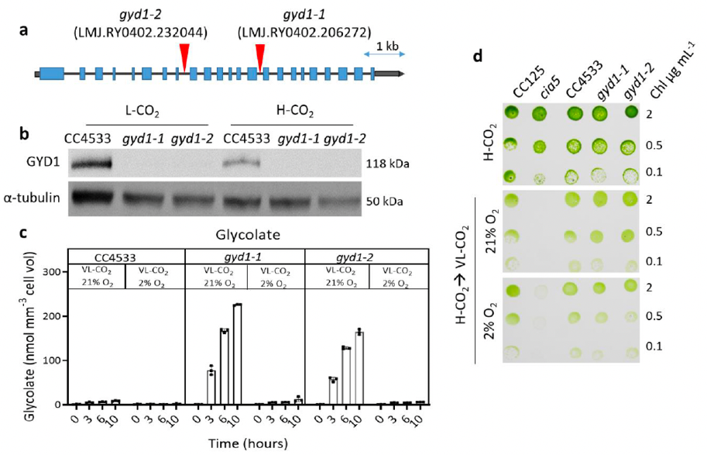
Characterization of two Chlamydomonas insertional mutants of the glycolate dehydrogenase gene GYD1
gyd1 mutants grow normally under low or high CO₂ concentration
gyd1 mutants excrete large amounts of glycolate under low CO₂ concentration, but not at low O₂ => related to photorespiration
gyd1 are convenient tools to measure the photorespiration rates in vivo
Dao et al. (2025) Nature Commun.

Slide 10
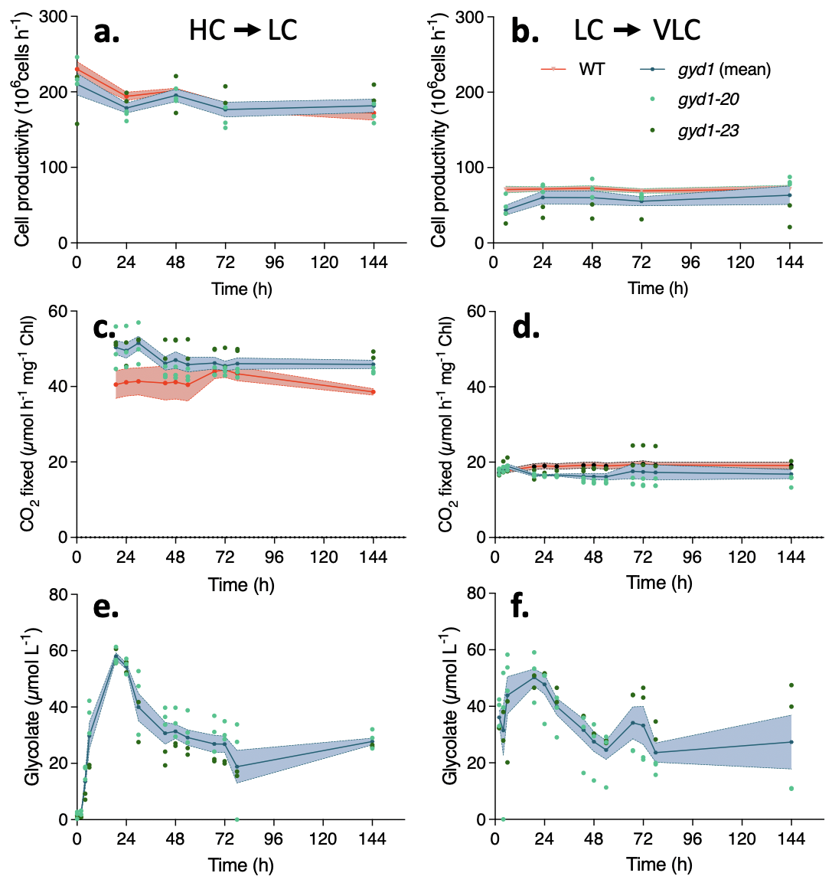
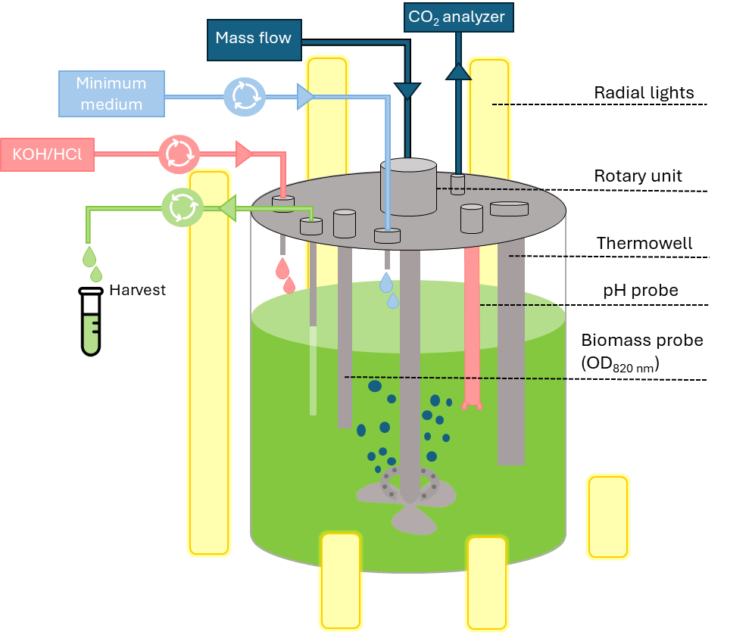
Use of glycolate dehydrogenase mutants to measure photorespiration carbon flux in vivo
Continuous cultures (turbidostats) allow to determine CO₂ and glycolate fluxes at steady state.
Glycolate production (photorespiration) rates are equivalent at LC and VLC despite different CO₂ fixation rates.
While energy demanding (ATP) external transporters of VLC are not that efficient in suppressing photorespiration.

Slide 11
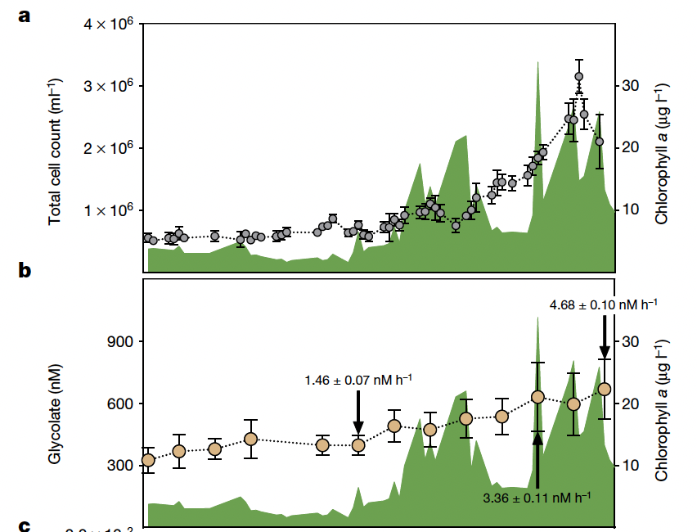
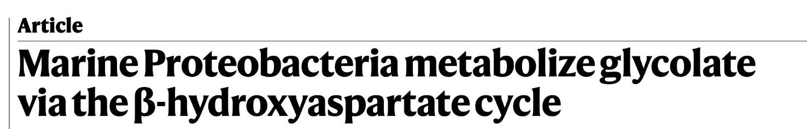
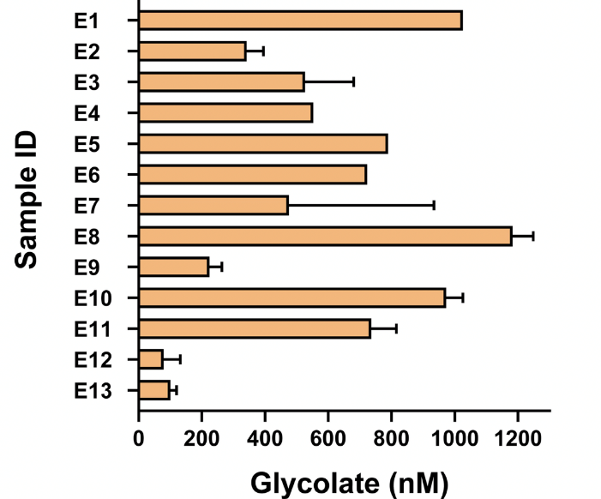
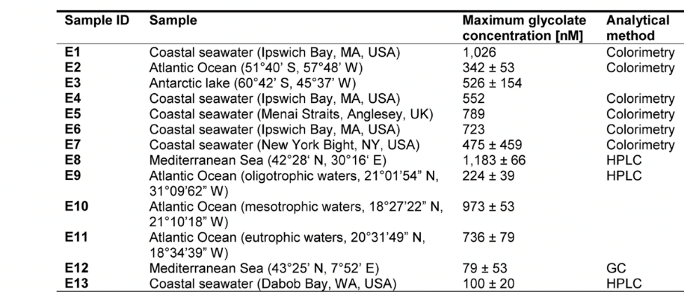
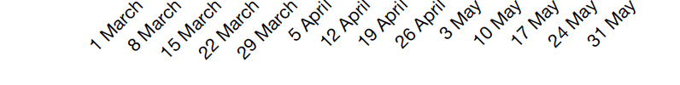
Photorespiratory carbon fluxes in aquatic ecosystems have been underestimated
von Borzyskowski et al. (2019) Nature
Glycolate concentration in seawater during a spring phytoplankton bloom at Helgoland (2018)

Slide 12
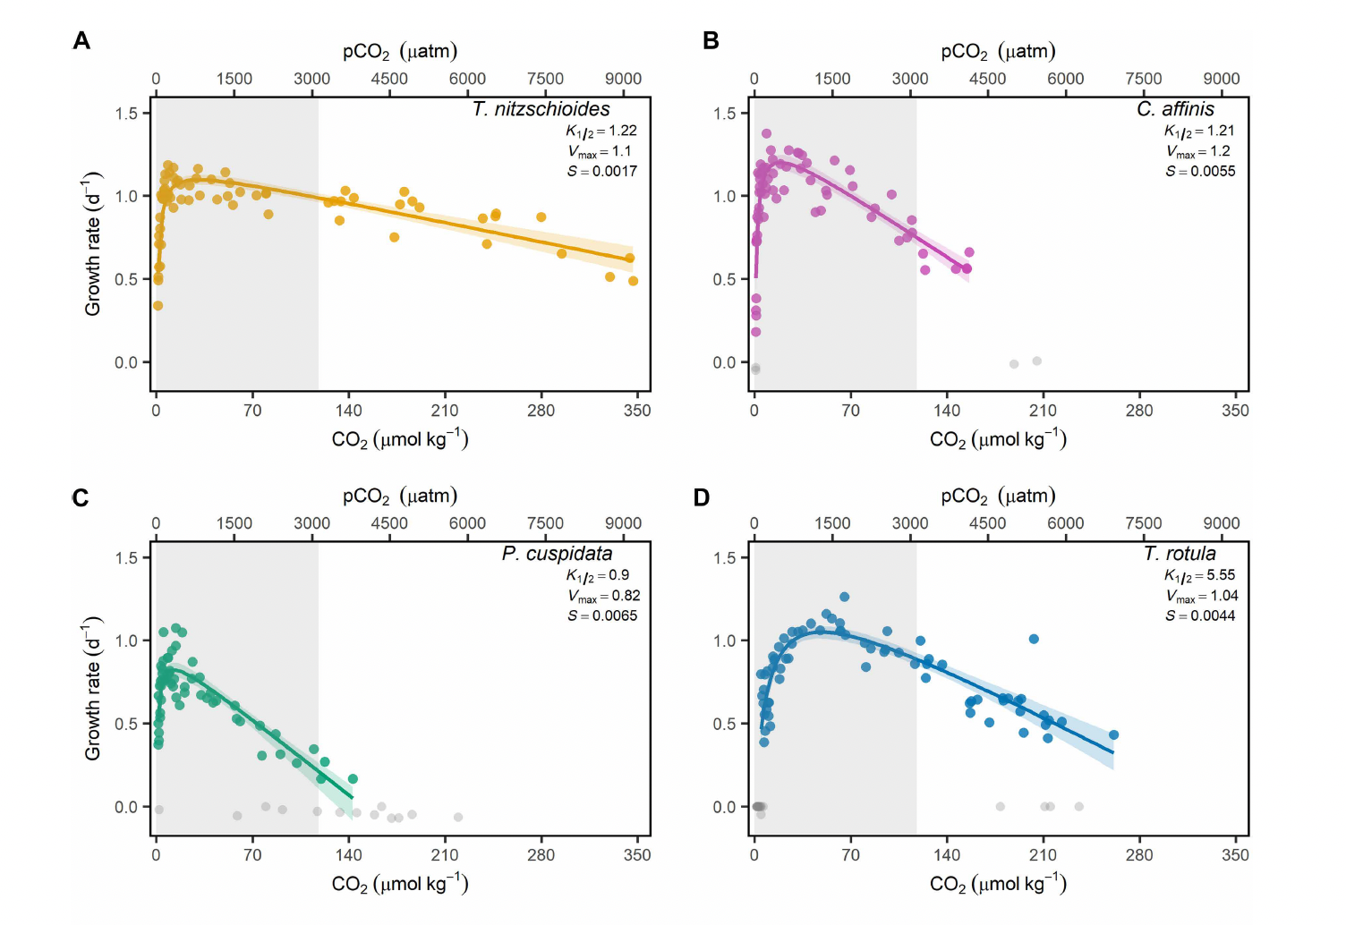
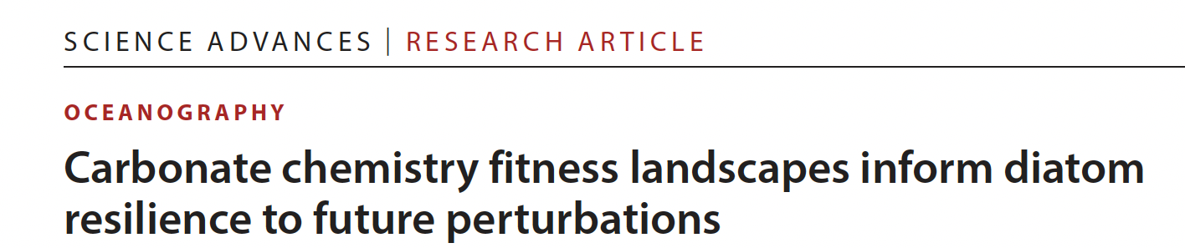
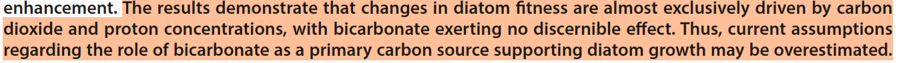
Diatoms fitness is almost exclusively driven by CO₂ and H⁺ concentrations
Ferderer et al. (2025) Sci. Adv.

Slide 13
Take home messages
Glycolate dehydrogenase mutants are convenient tools to evaluate photorespiration carbon losses in vivo
Bicarbonate transporters induced at VLC are energy demanding and not very efficient in reducing photorespiration.
This may explain why glycolate is produced in the ocean, where CO₂ is limited and, despite its abundance, bicarbonate is inefficiently utilized by phytoplankton species.

Slide 14
Future plans
Evaluate the efficiency of CCM components (transporters, starch sheath…) and of Rubisco condensation in reducing carbon losses by photorespiration.
Extend the work to other photosynthetic micro-organisms (diatoms, cyanobacteria…).
Determine which algal species produce glycolate in natural environments, and in which locations…

Slide 15
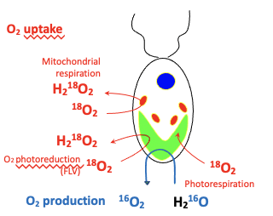
Measurement of photosynthetic O₂ exchange by MIMS in the presence of ¹⁸O-enriched O₂
Ion source
Project
Characterize the O₂ dependency of O₂ uptake in the different mutants
Does the mis-assembly of the pyrenoid generate a CO₂ dependent component of O₂ uptake (could be related to photorespiration)?
Burlacot et al. (2020) Front. Plant Sci.
Burlacot et al. (2022) Nature

Slide 16
In Chlamydomonas, two distinct CCM regimes: Low CO₂ and Very Low CO₂
BST
HCO₃⁻
O₂
HCO₃⁻
CAH3
x
LCIB
RuBP
CO₂
P-Glycolate
CBB
O₂
LCIC
PGLP1
CO₂
x
3-PGA
Rubisco
Glycolate
GLYK
EPYC1
Glycerate
x
CO₂
CO₂
Chloroplast envelope
starch
Starch
Thylakoid pH 5.5
Chloroplast
Glycerate
Glycolate excretion
Glycolate
HPR1
Hydroxypyruvate
GYD1
SGAT
Glyoxylate
Glu
AAT1
Mitochondria
SHMT1
Oxo
GDH
Serine
Glycine
GDC-H
CO_{2,} NH₃

Slide 17
In Chlamydomonas, two distinct CCM regimes: Low CO2 and Very Low CO₂
BST
ACA4
HCO₃⁻
O₂
H⁺
LCIA
HCO₃⁻
CAH3
x
ATP
LCIB
RuBP
CO₂
P-Glycolate
HLA3
CBB
O₂
HCO₃⁻
LCIC
PGLP1
HCO₃⁻
CO₂
x
3-PGA
Rubisco
Glycolate
CAH1
ATP
GLYK
EPYC1
LCI1
Glycerate
x
CO₂
CO₂
Chloroplast envelope
starch
Starch
Thylakoid pH 5.5
Chloroplast
Glycerate
Glycolate excretion
ATP
Glycolate
HPR1
Hydroxypyruvate
GYD1
SGAT
Glyoxylate
Glu
AAT1
Mitochondria
SHMT1
Oxo
GDH
Serine
Glycine
GDC-H
CO_{2,} NH₃
Burlacot et al. (2022) Nature

Slide 18
How supramolecular organization of Rubisco affects its activity and photorespiration?
Glycolate excretion
serine
glycine
CO₂ + NH₃
glyoxylate
GYD
Carbon
Reduction
Cycle
glycolate
NADP⁺
Photorespiration
H⁺
NADPH
HCO₃⁻
CEF &
PCEF
LEF
PGPase
Low CO₂
H₂O
CO₂
P-glycolate
LCIB/
LCIC
BST1-3
H⁺
HCO₃⁻
CAH3
CO₂
CO₂
Chloroplast envelope
O₂
Plasma membrane
Rubisco
Cytosol
Stroma
Lumen
Pyrenoid

Slide 19
In Chlamydomonas, two distinct CCM regimes: Low CO2 and Very Low CO₂
BST
ACA4
ATP
HCO₃⁻
O₂
H⁺
LCIA
HCO₃⁻
CAH3
x
HLA3
LCIB
RuBP
CO₂
P-Glycolate
CBB
O₂
HCO₃⁻
LCIC
PGLP1
HCO₃⁻
CO₂
x
3-PGA
Rubisco
Glycolate
CAH1
GLYK
EPYC1
LCI1
Glycerate
x
CO₂
CO₂
Chloroplast envelope
starch
Starch
Thylakoid pH 5.5
Chloroplast
Glycerate
Glycolate excretion
Glycolate
HPR1
Hydroxypyruvate
GYD1
SGAT
Glyoxylate
Glu
AAT1
Mitochondria
SHMT1
Oxo
GDH
Serine
Glycine
GDC-H
CO_{2,} NH₃

